Slide 1
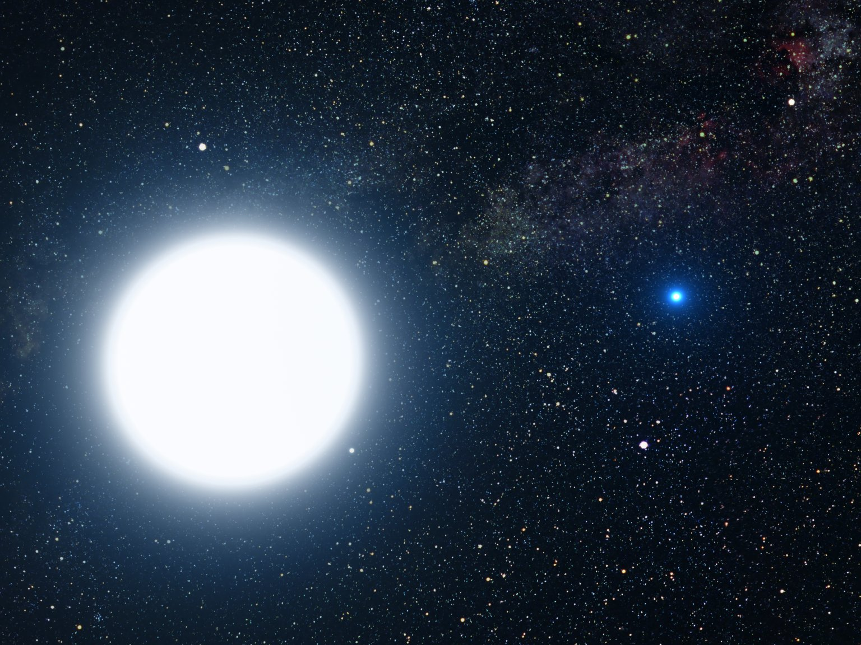
Estrelas
Nascimento
Vida
Morte
João Paulo M. Cruvinel da Costa – Centro de Divulgação da Astronomia - USP
Notes:
NASA
http://www.nasaimages.org/luna/servlet/detail/NVA2~8~8~14212~114753:Astronomers-Use-Hubble-to--Weigh--D

Slide 2
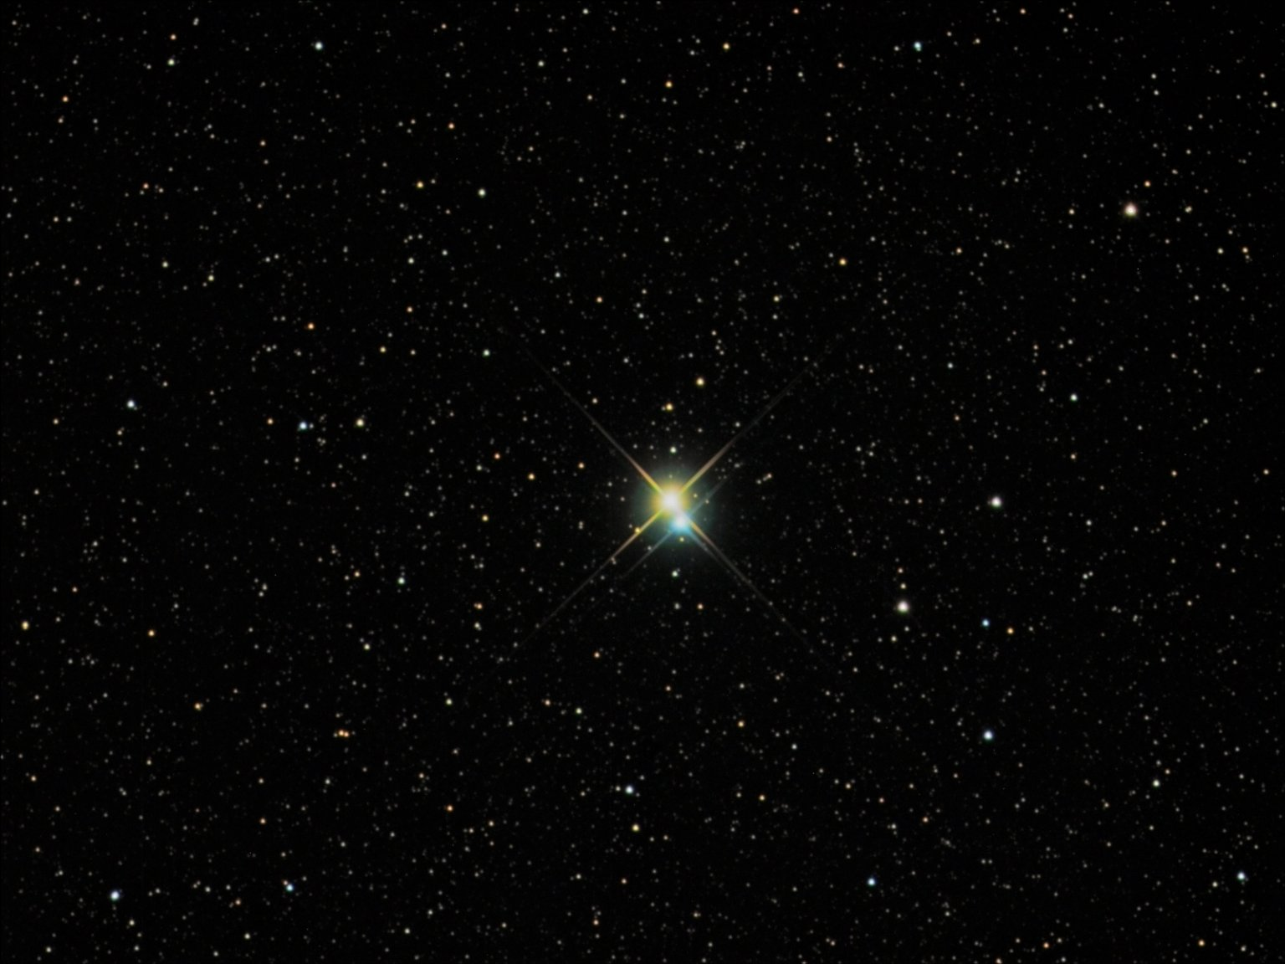
Notes:
Richard Yandrick
http://www.nasaimages.org/luna/servlet/detail/NVA2~4~4~5751~106277:Albireo--A-Bright-and-Beautiful-Dou -

Slide 3
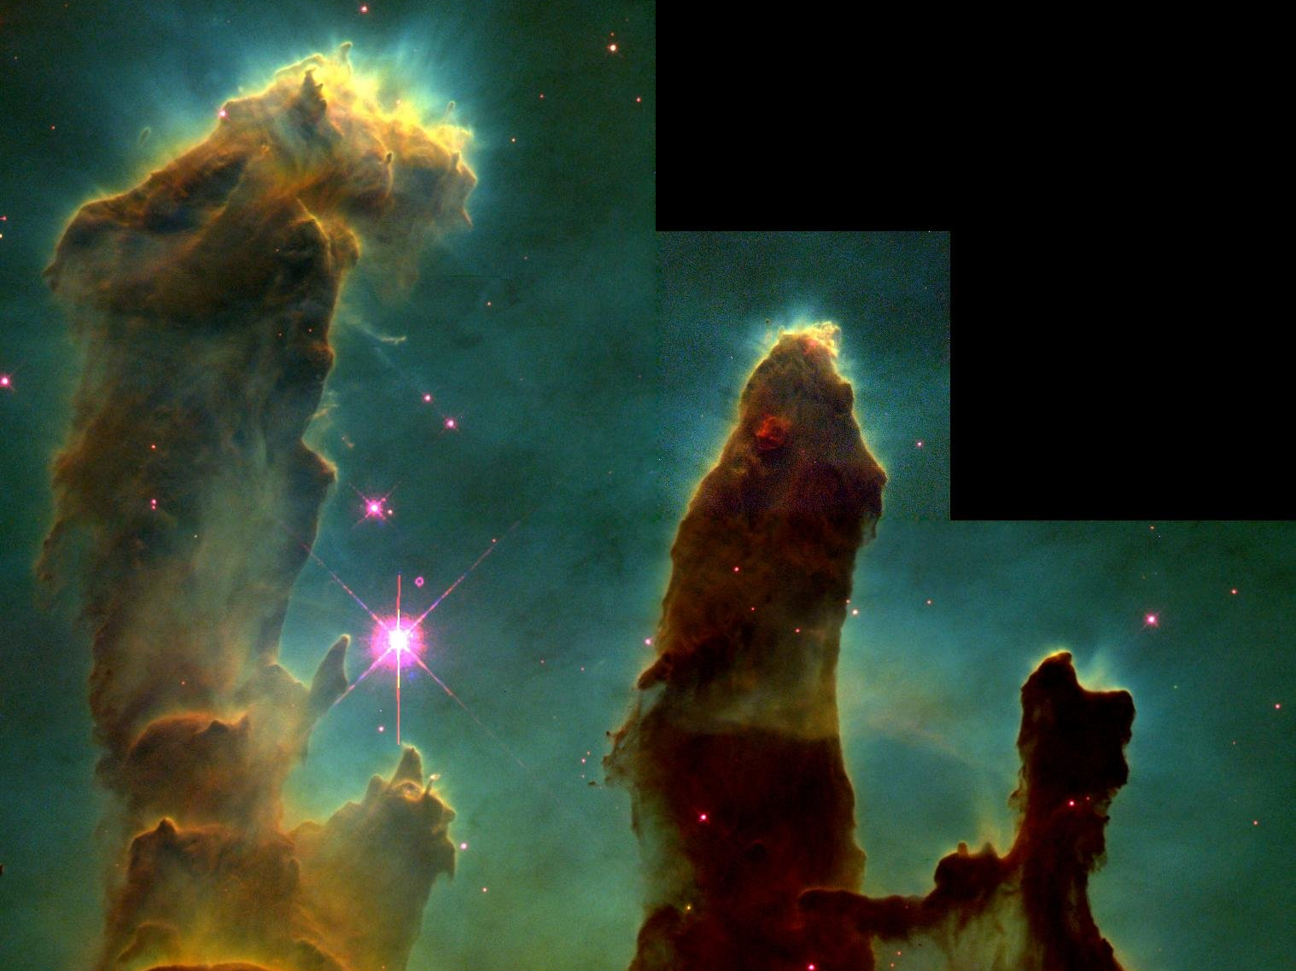
Notes:
J. Hester, P. Scowen
http://www.nasaimages.org/luna/servlet/detail/NVA2~4~4~6286~106812?qvq=q:+Pillars+of+Creation

Slide 6
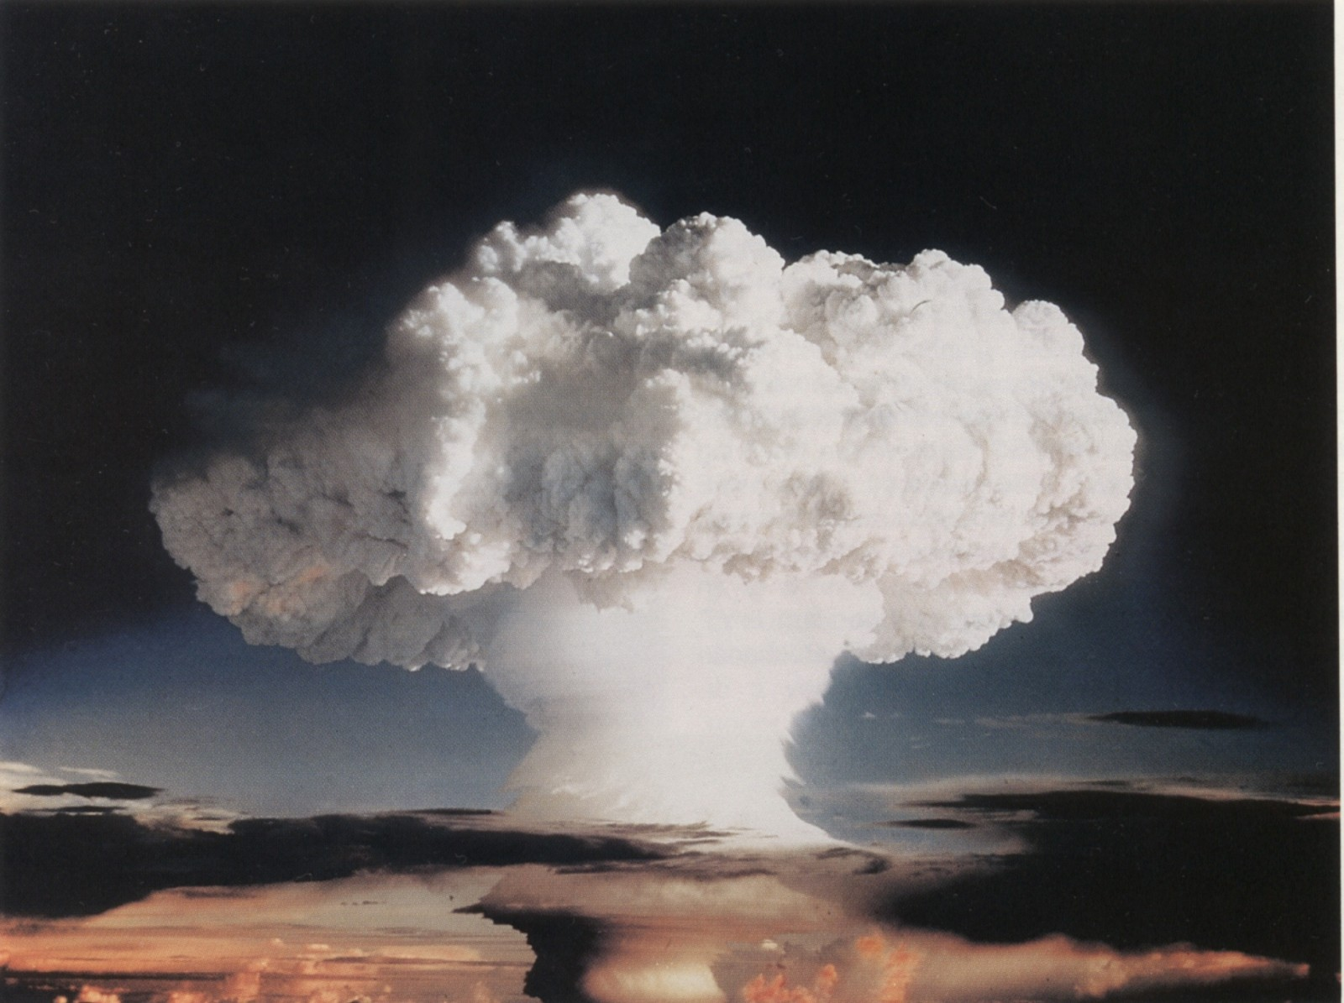
Notes:
http://nuclearweaponarchive.org/Usa/Tests/Ivy.html

Slide 7
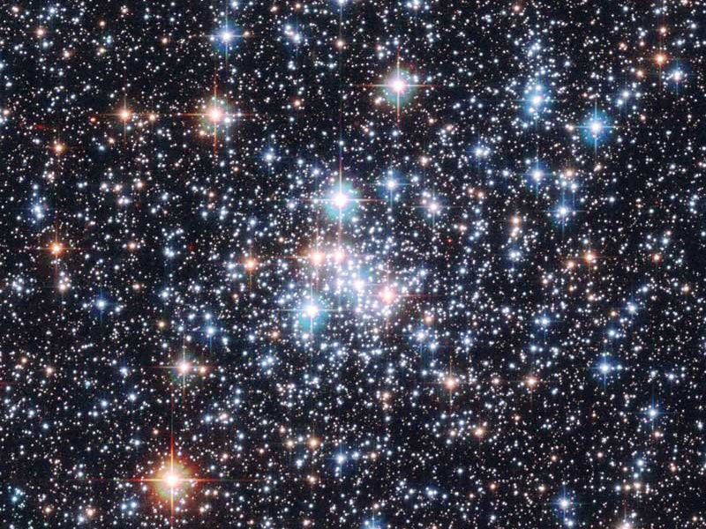
Notes:
E. Olszewski
http://www.nasaimages.org/luna/servlet/detail/NVA2~4~4~5994~106520:Open-Cluster-NGC-290--A-Stellar-Jew

Slide 8
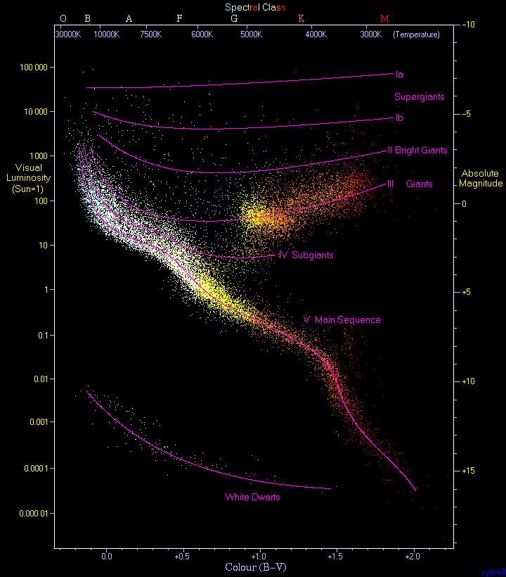
Notes:
Richard Powell
http://commons.wikimedia.org/wiki/File:H-R_diagram_-edited-3.gif

Slide 9
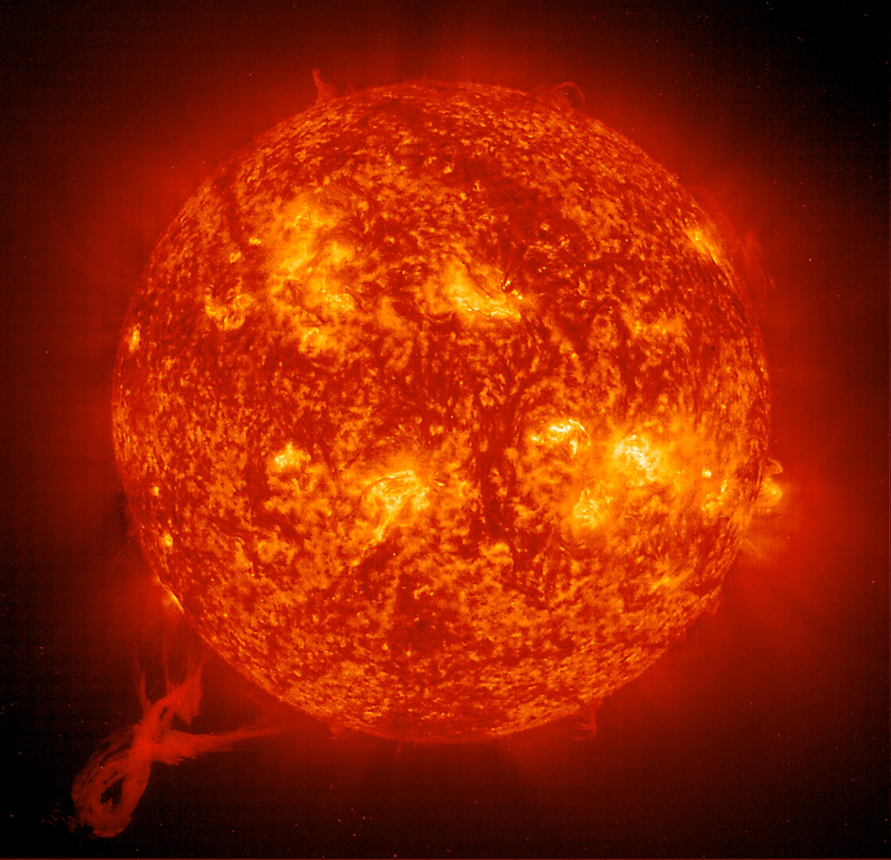
Notes:
NASA Solar and Heliospheric Observatory Collection
http://www.nasaimages.org/luna/servlet/detail/NVA2~9~9~11918~112450:Twisting-prominence--An-EIT-304

Slide 10
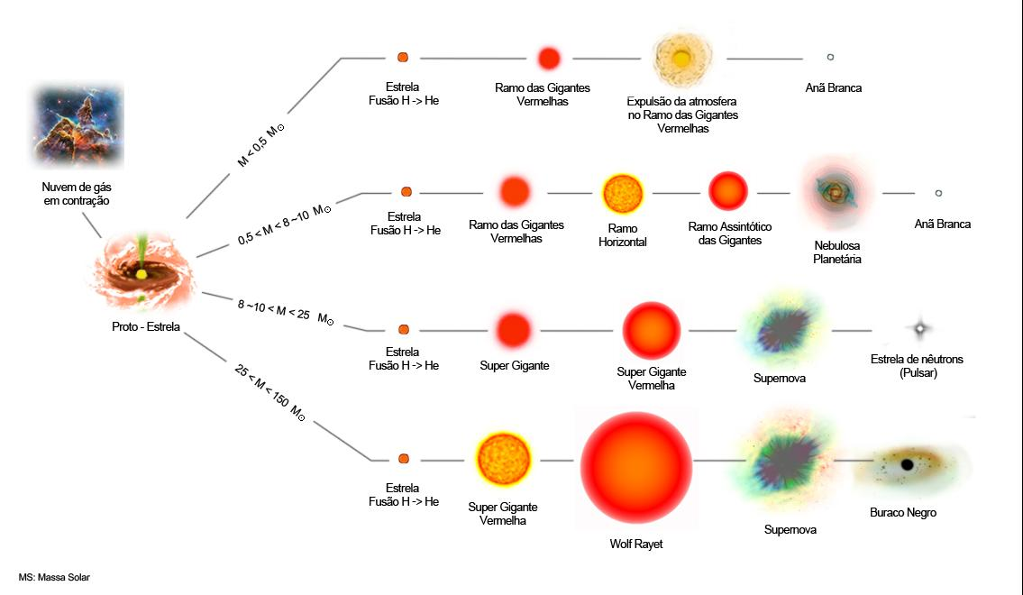

Slide 11
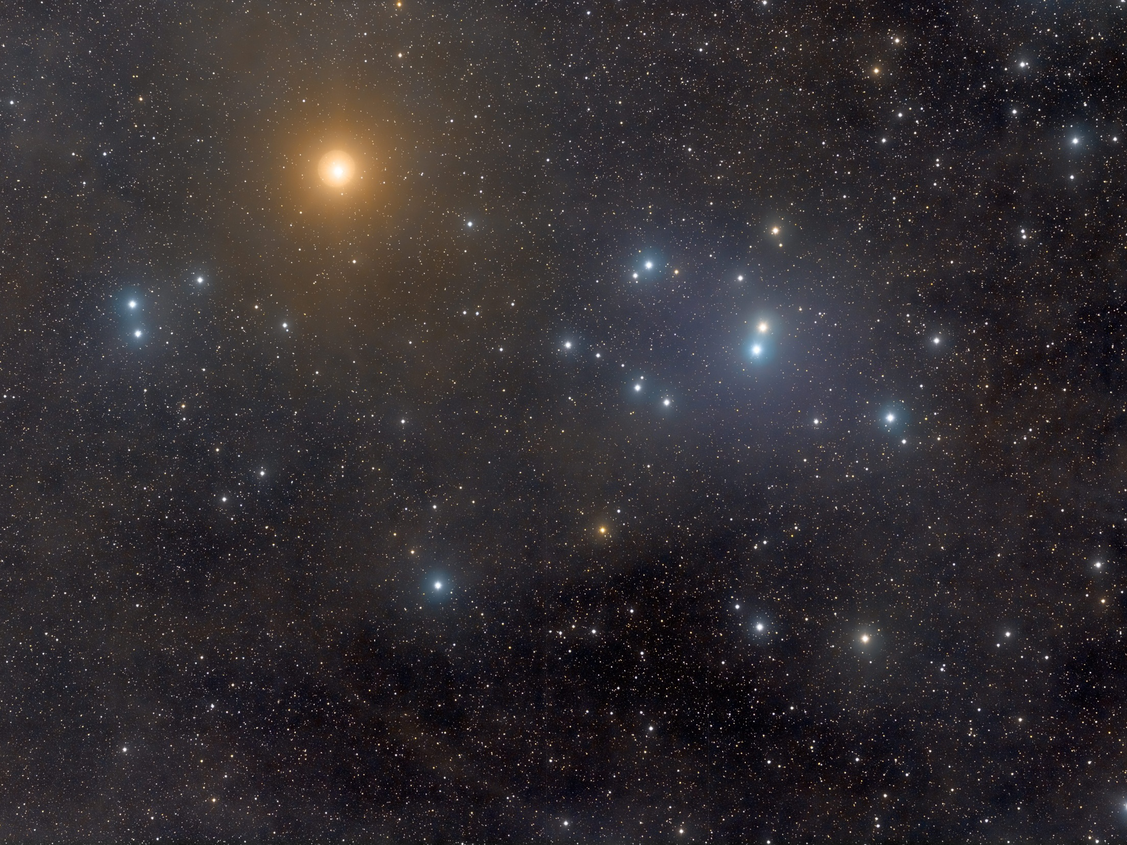
Notes:
http://bitacoradegalileo.files.wordpress.com/2010/11/2010-09-05_hyades.jpg

Slide 12
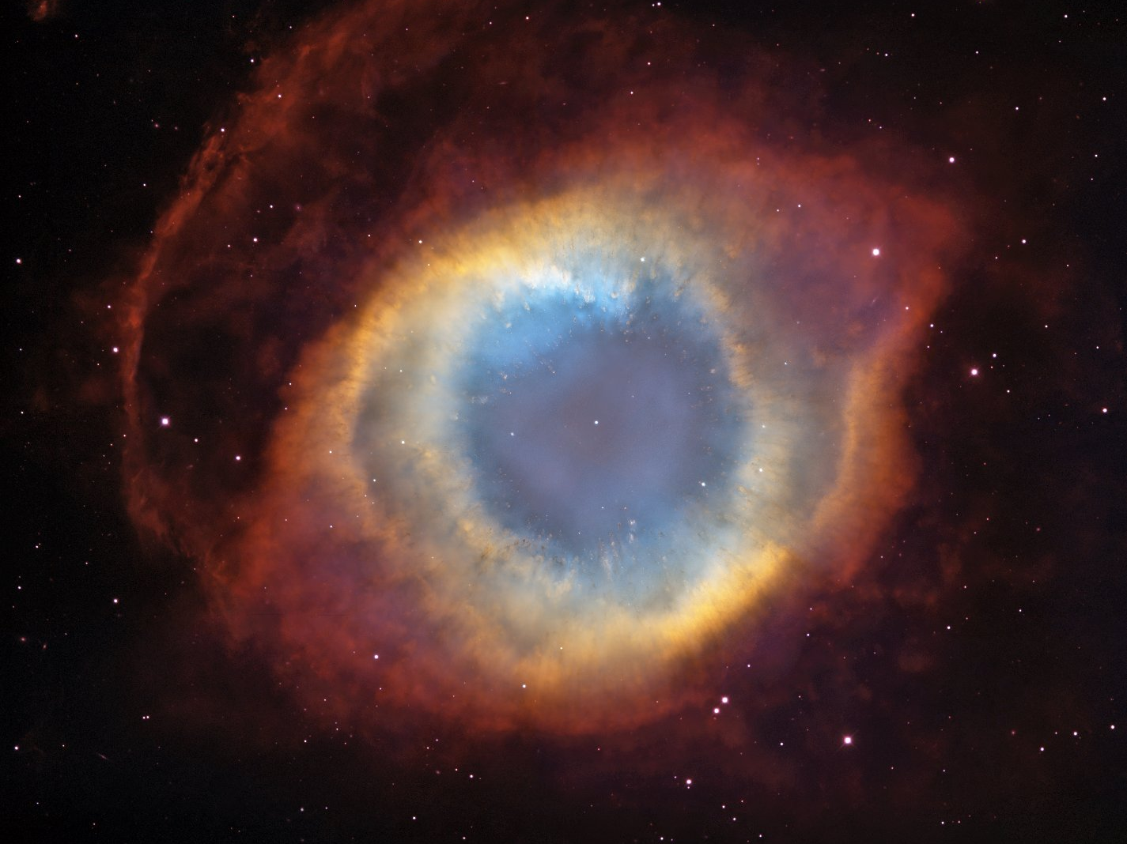
Notes:
C.R. O'Dell (Vanderbilt University), M. Meixner and P. McCullough
http://www.nasaimages.org/luna/servlet/detail/NVA2~8~8~13956~114497:A-New-Twist-on-an-Old-Nebula

Slide 13
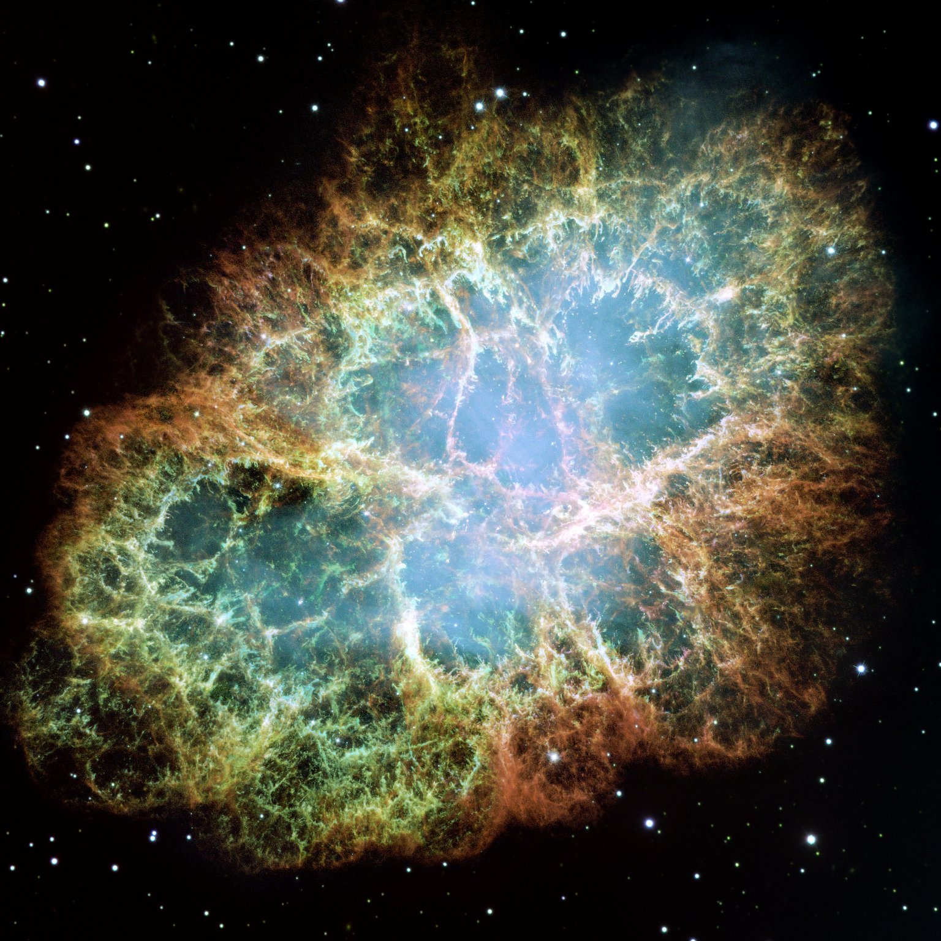
Notes:
NASA/ESA/JPL/Arizona State Univ.
http://www.nasaimages.org/luna/servlet/detail/nasaNAS~4~4~17233~121050:Most-Detailed-Image-of-the-Crab-Neb?

Slide 14
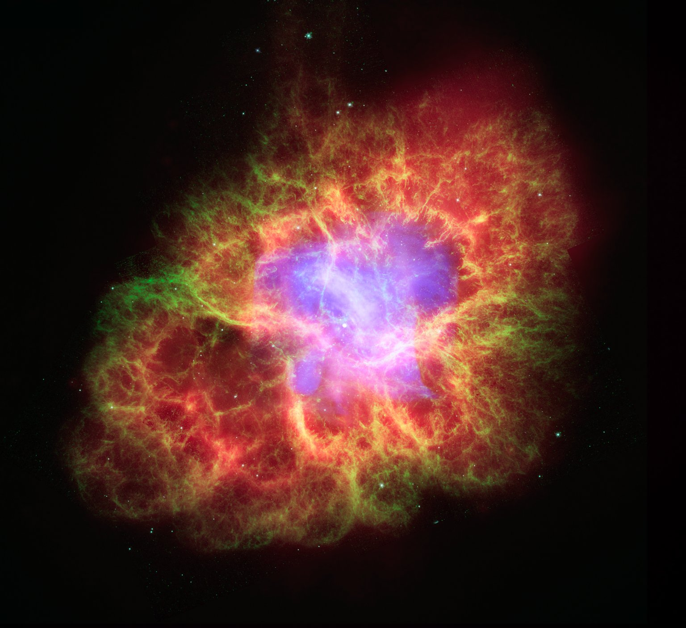
Notes:
NASA/JPL-Caltech/R.G ehrz (Univ. Minn.)
http://www.nasaimages.org/luna/servlet/detail/nasaNAS~12~12~64141~168525:The-Spirit-of-Halloween-Lives-On-as

Slide 15
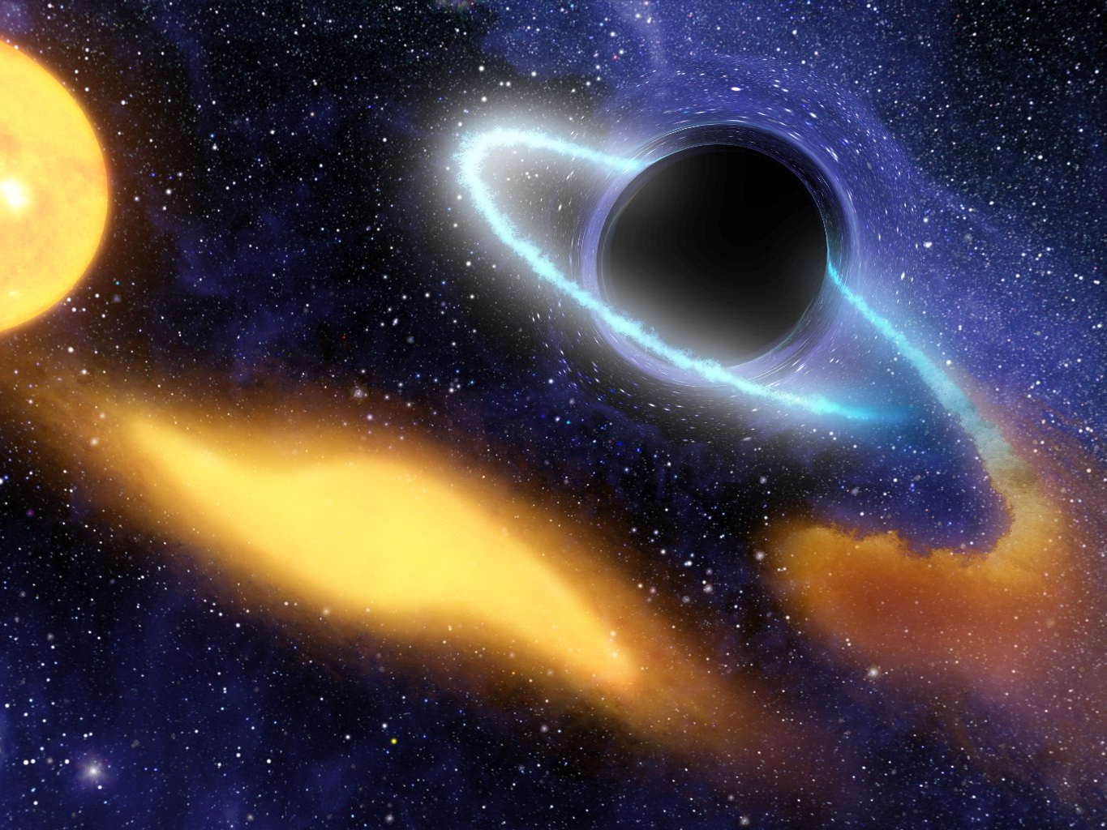
Notes:
NASA/JPL-Caltech
http://www.nasaimages.org/luna/servlet/detail/nasaNAS~4~4~14040~116394:Black-Hole-Grabs-Starry-Snack?

Slide 16
?

Slide 17
www.cdcc.usp.br/cda
joao.monteiro.costa@usp.br

