Slide 2
COMETAS E HUMANIDADE
Luciana Reis
barroslgr@gmail.com
Imagem de fundo: céu observável no ODS hoje, 09/09/2017, às 21h. Crédito: Stellarium

Slide 3
O que é um cometa?

Slide 4
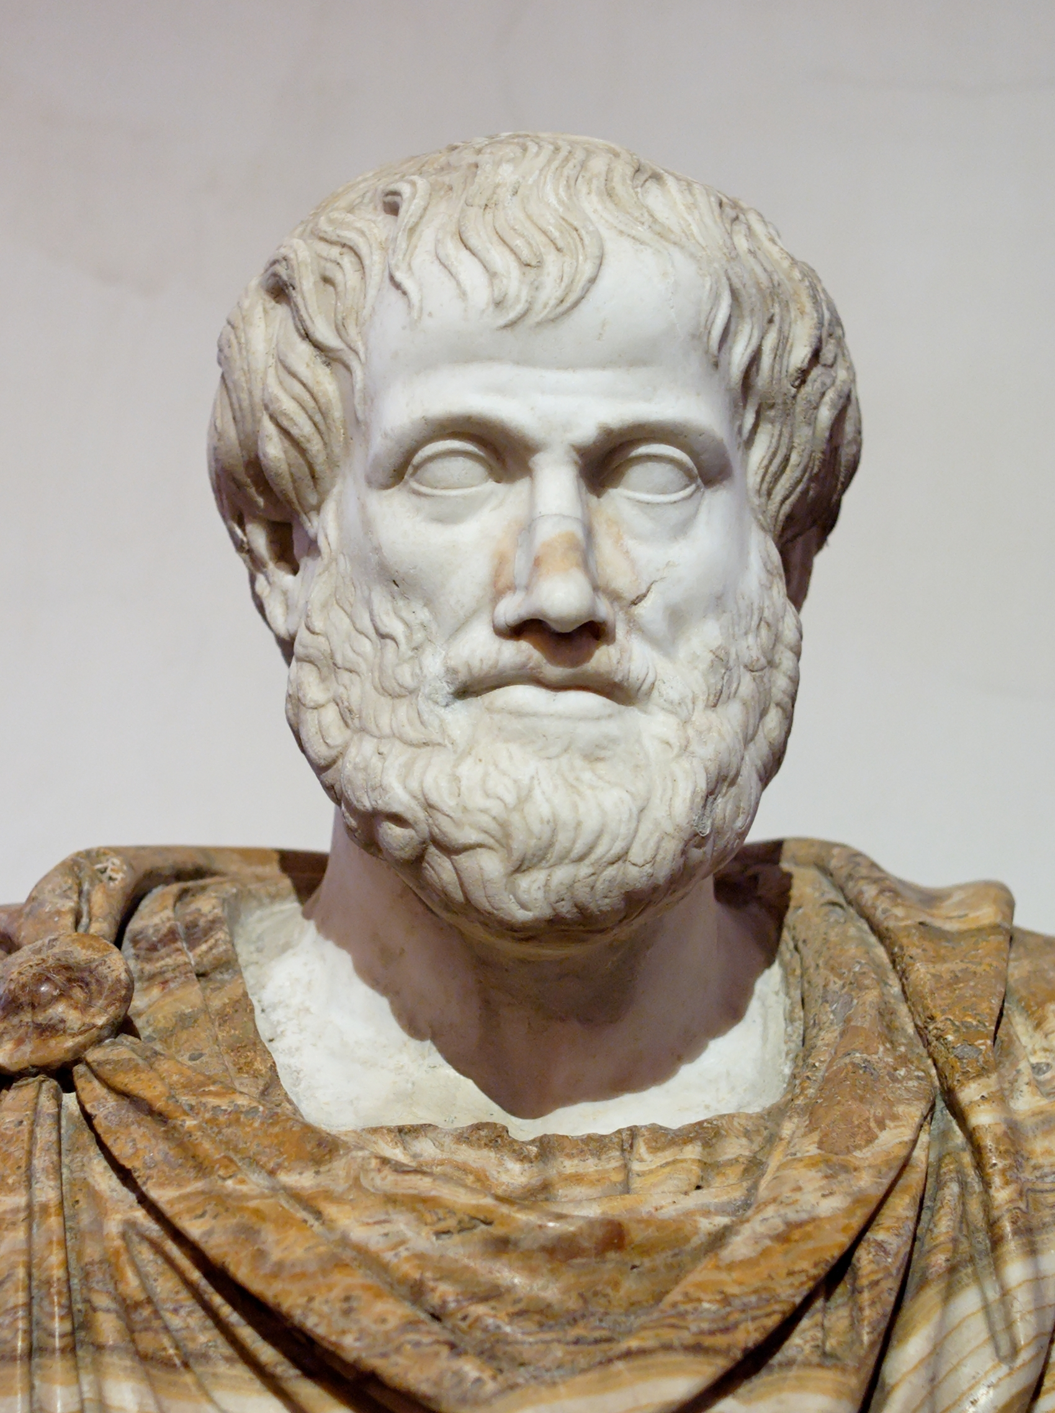
Aristóteles: apenas um fenômeno atmosférico

Slide 5
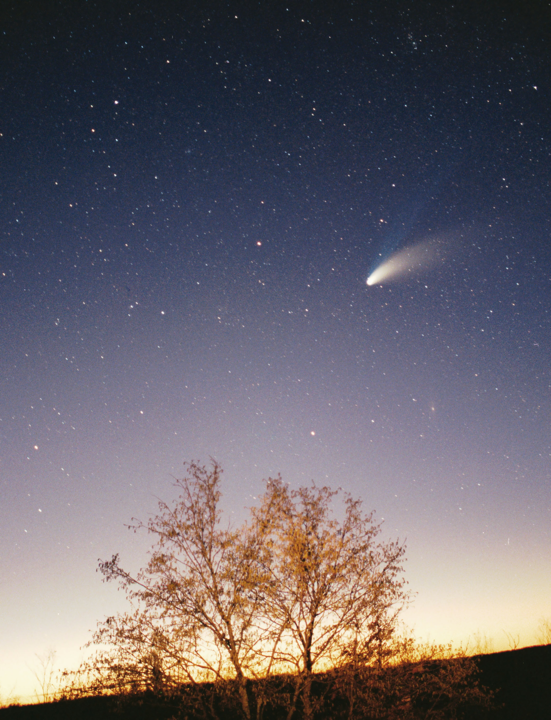
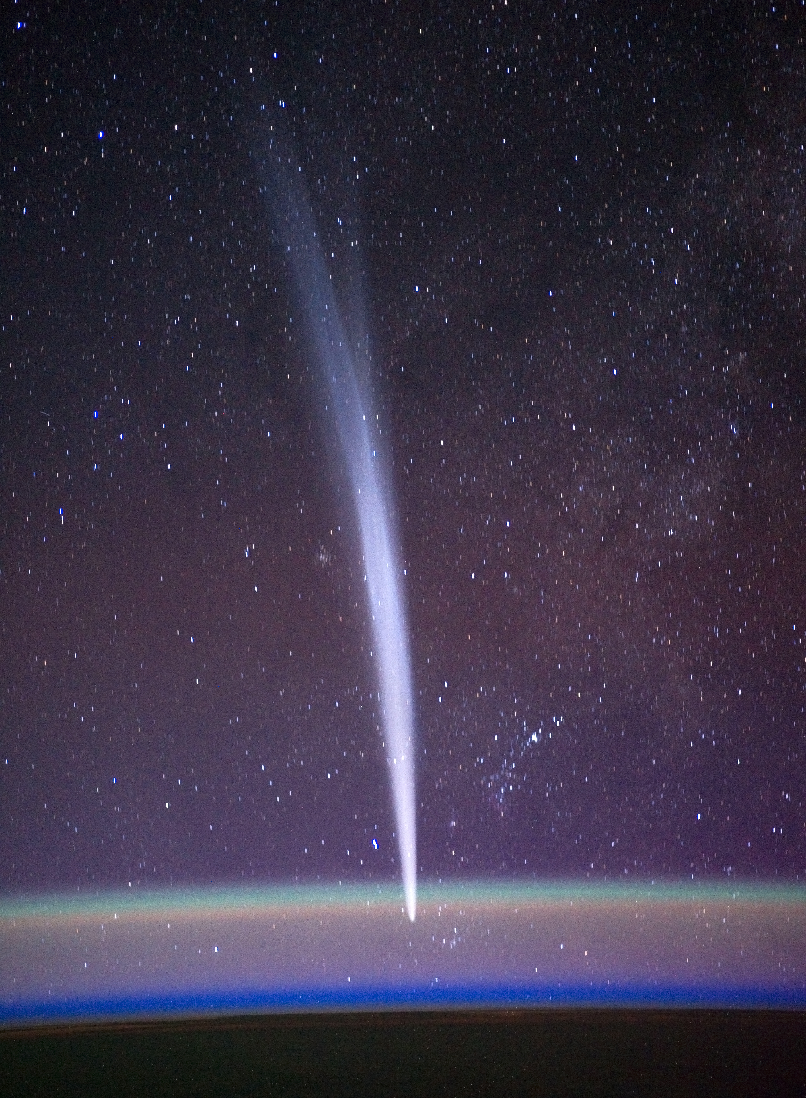
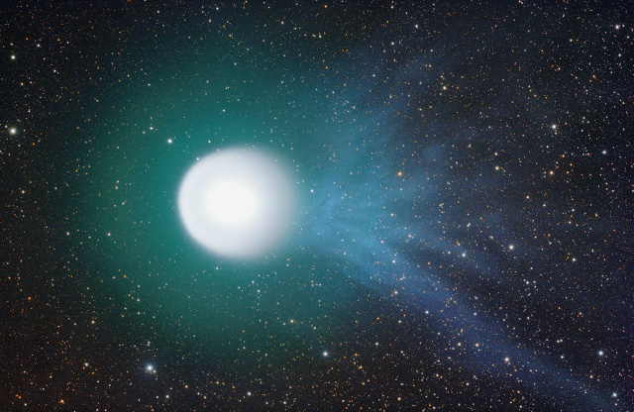
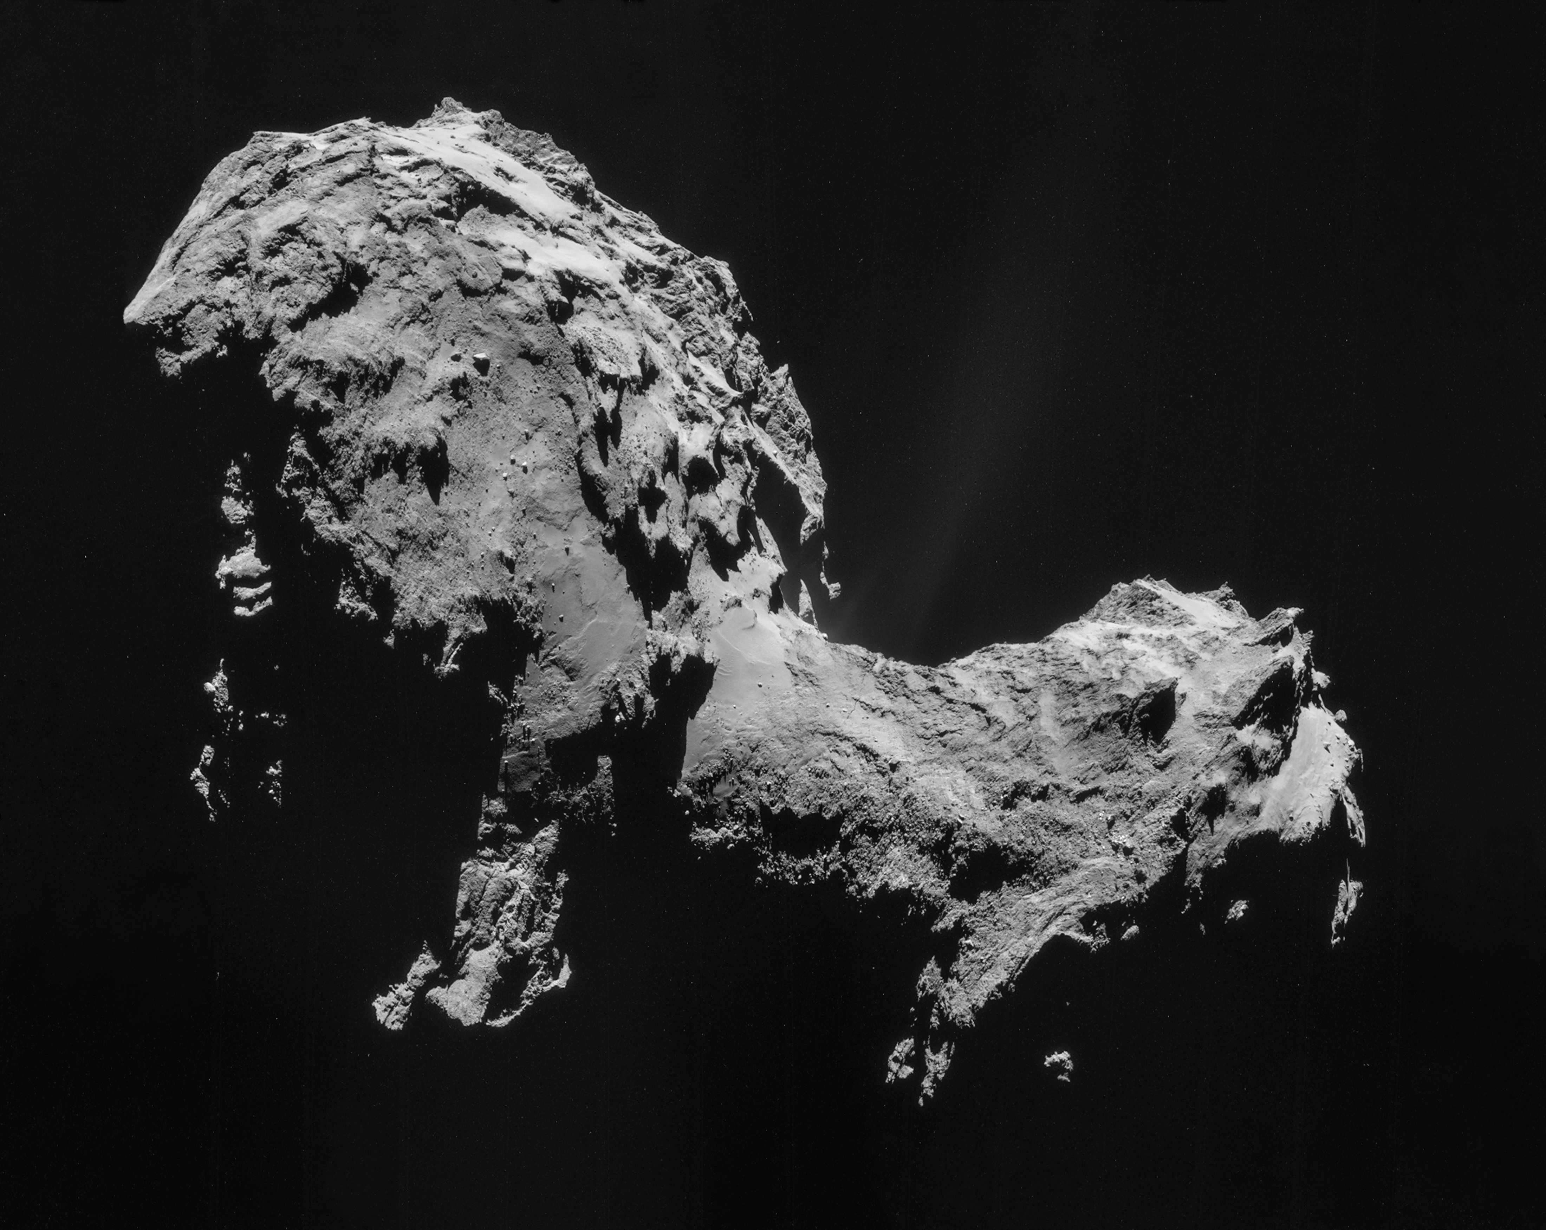

Slide 6
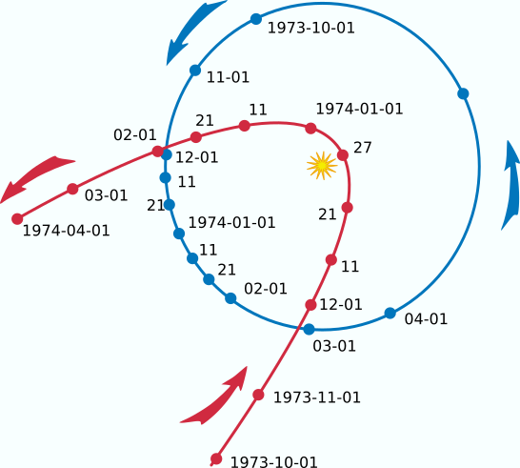
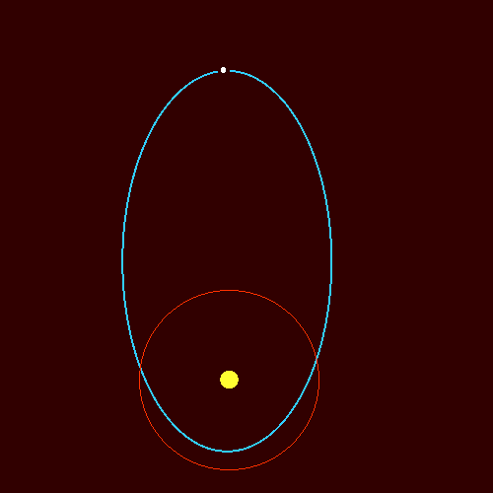

Slide 7
Pré-história

Slide 8
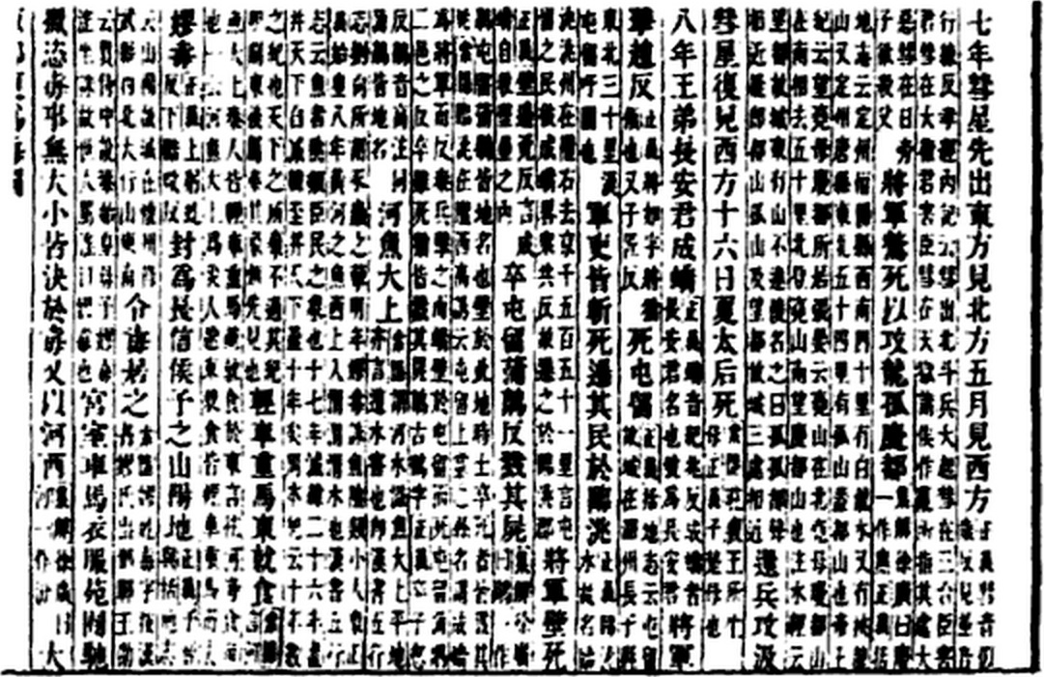
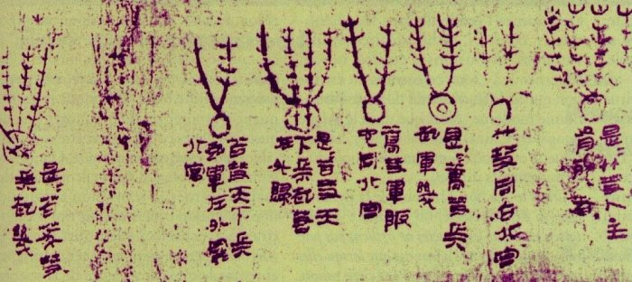
Anais Chineses: 2317 a.C.

Slide 9
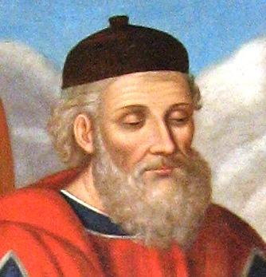
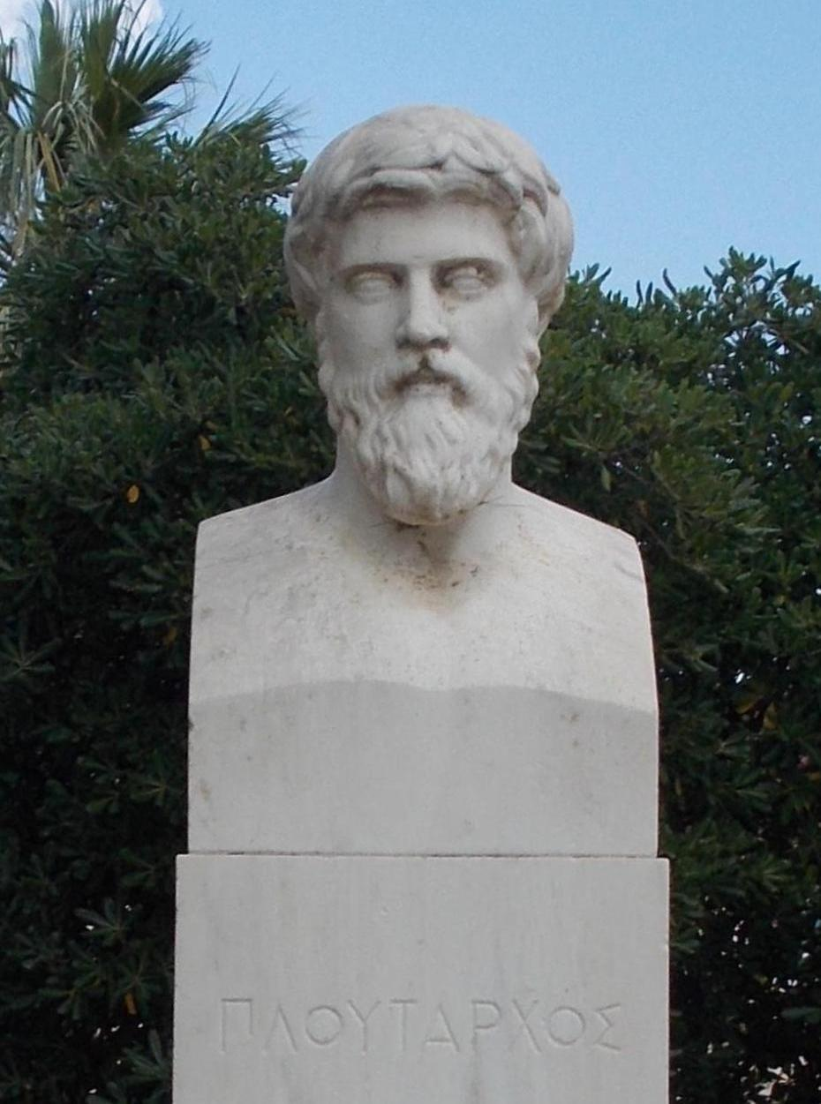
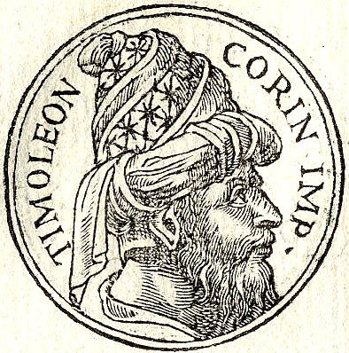
Diodorus Siculus, Plutarco e Timoleon: 344 a.C.

Slide 10
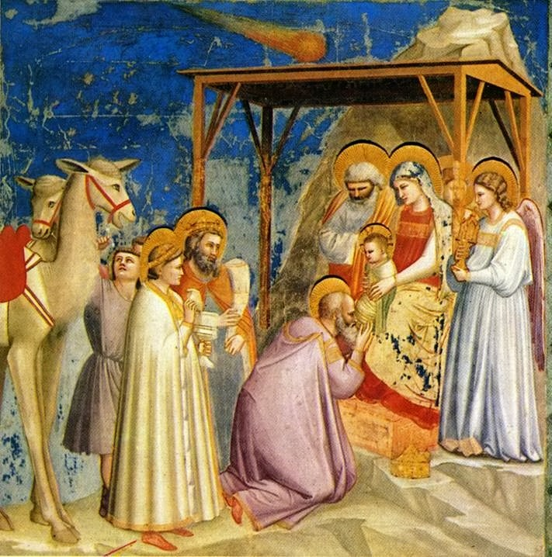
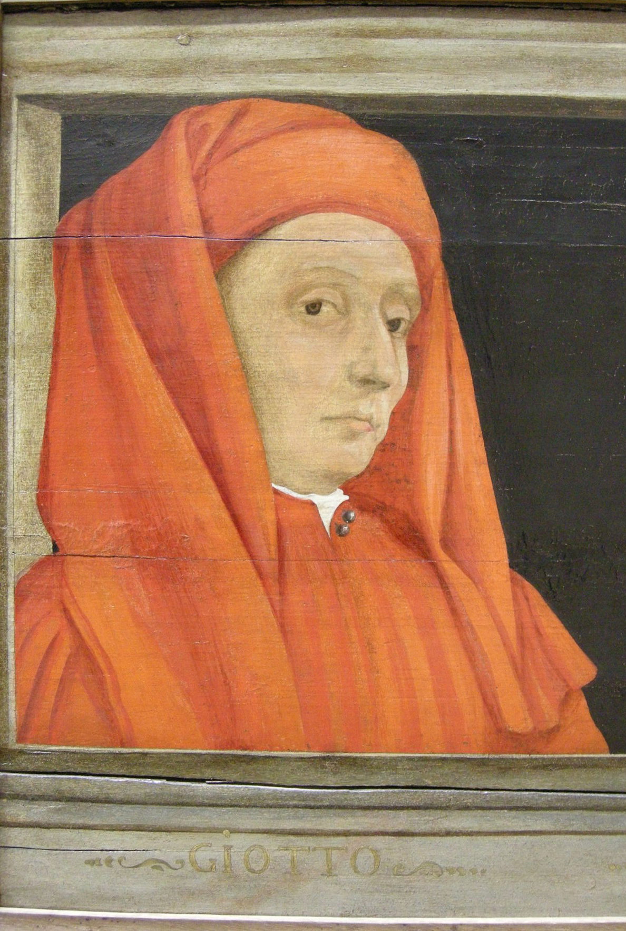
“Adoração dos Magos”, de Giotto, Pádua, 1301

Slide 11
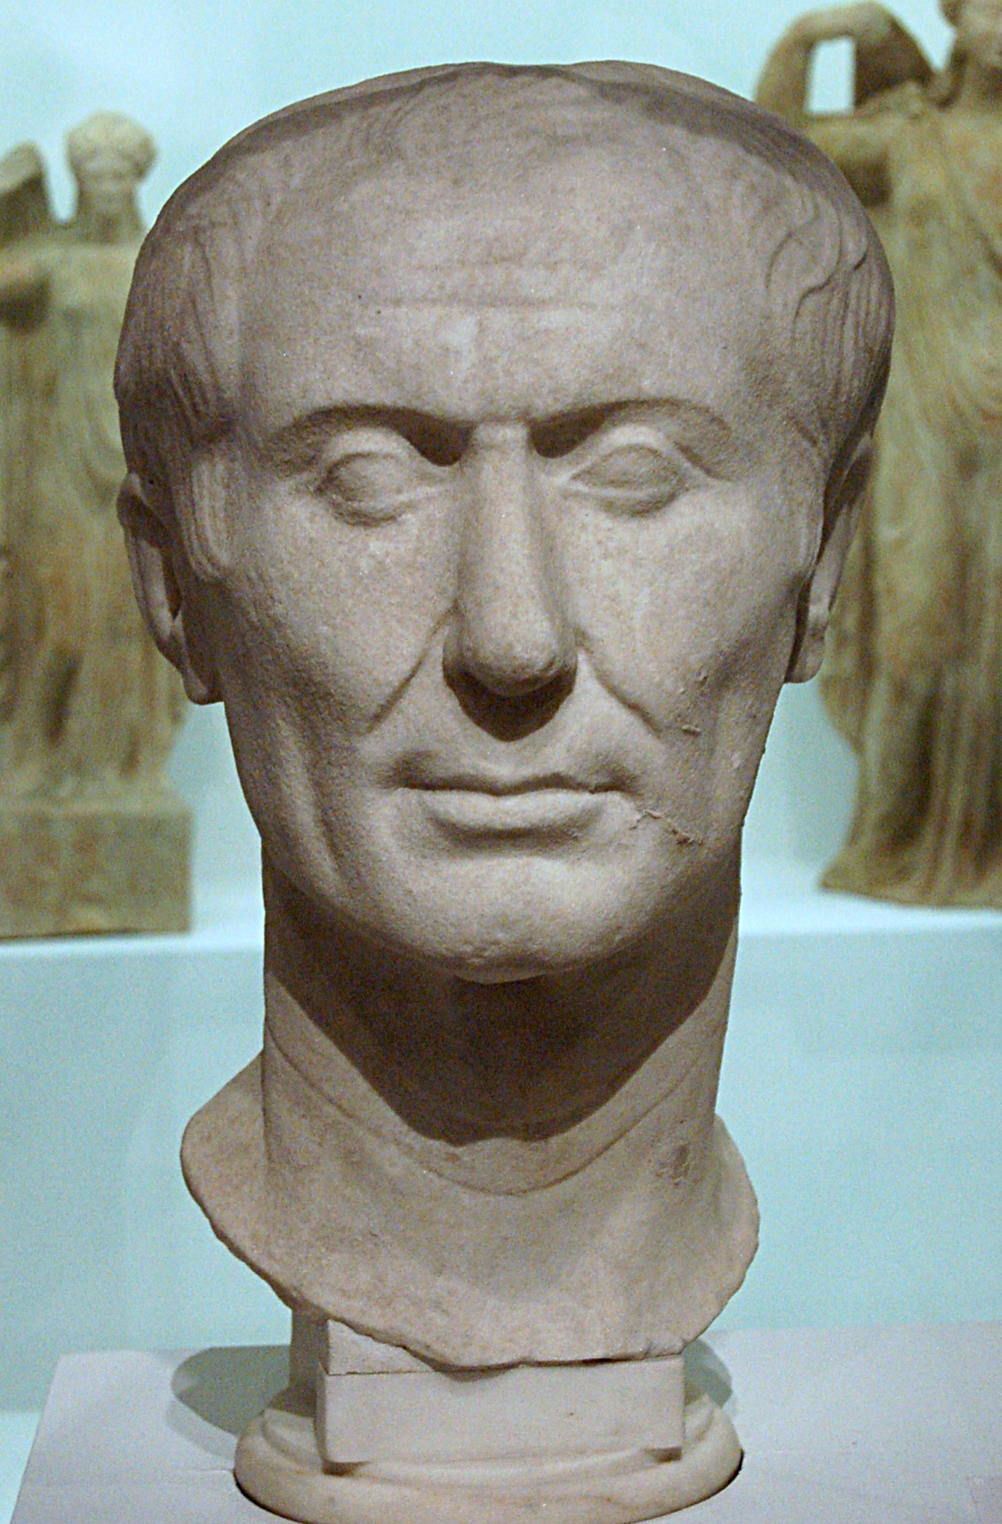
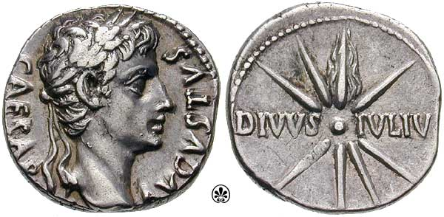
A alma de Julio Cesar: 44 a.C.

Slide 12
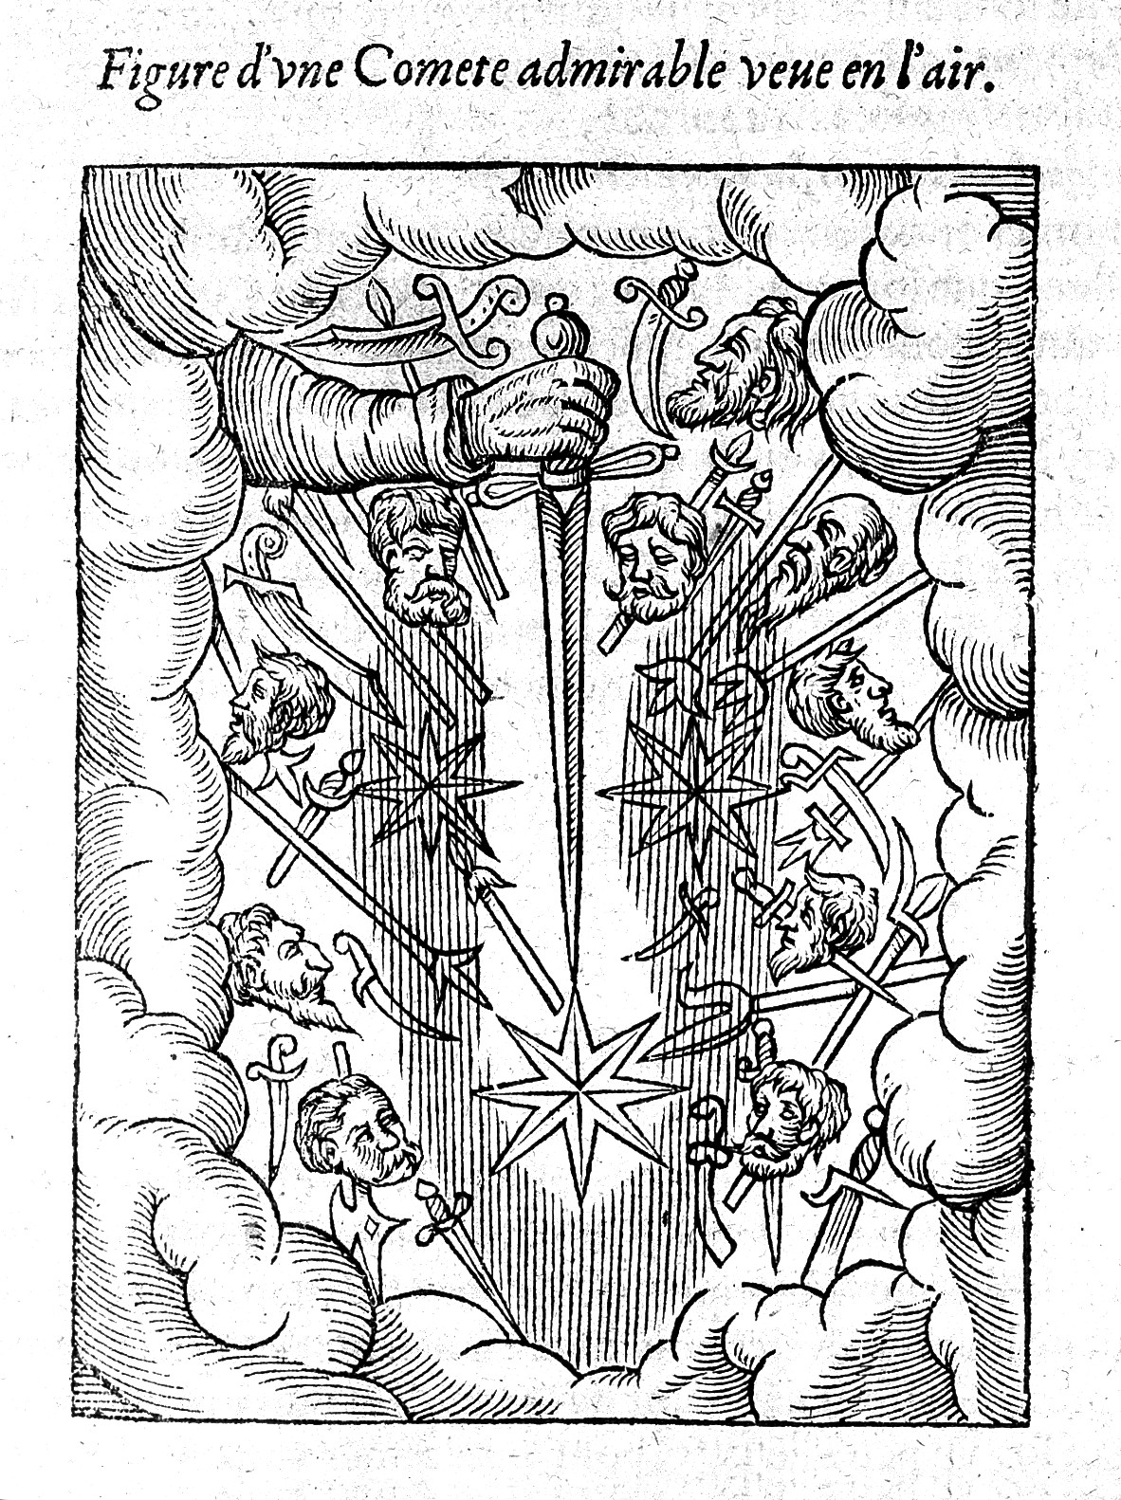
Cometa Paré: 1528

Slide 13
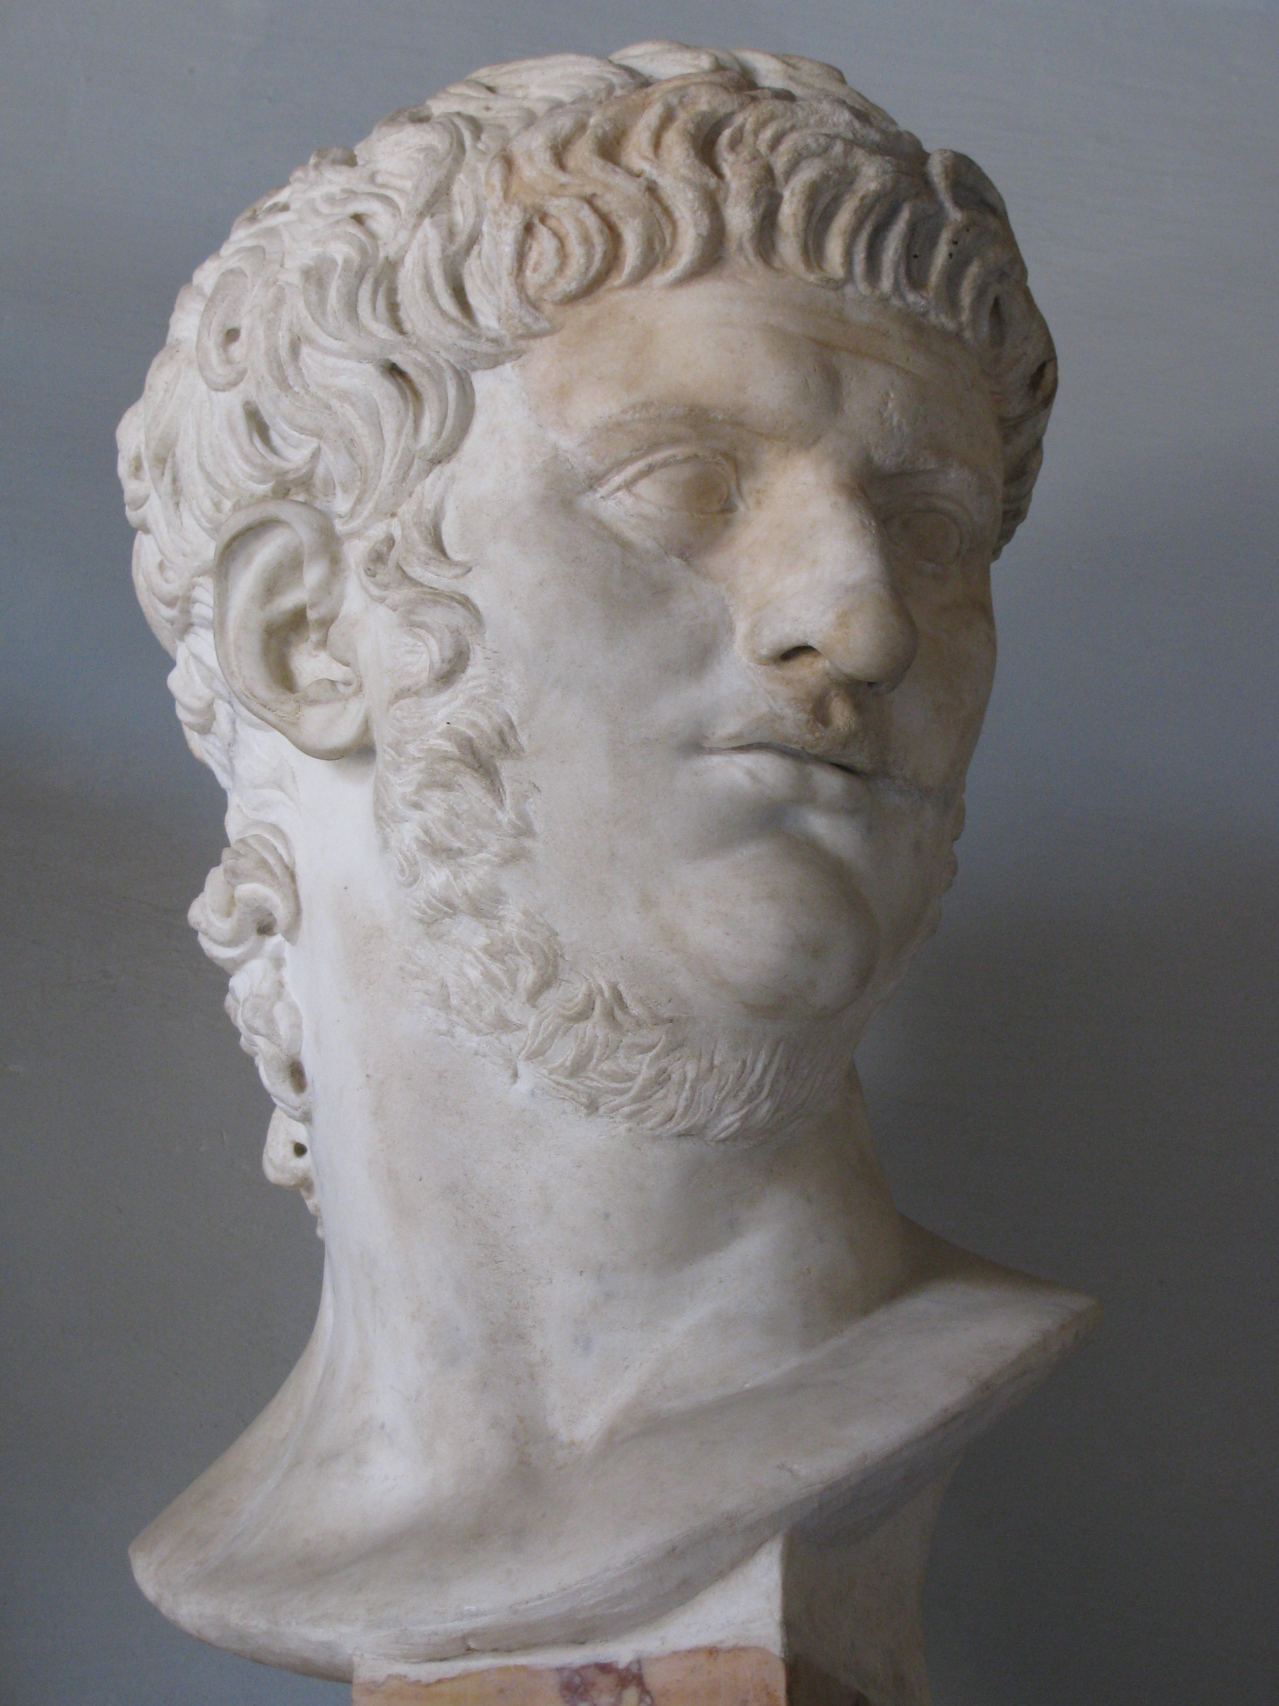
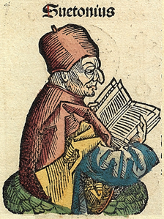
Nero segundo Suetonius: maldade influenciada

Slide 14
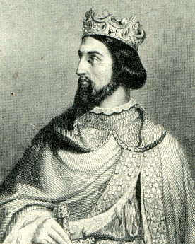
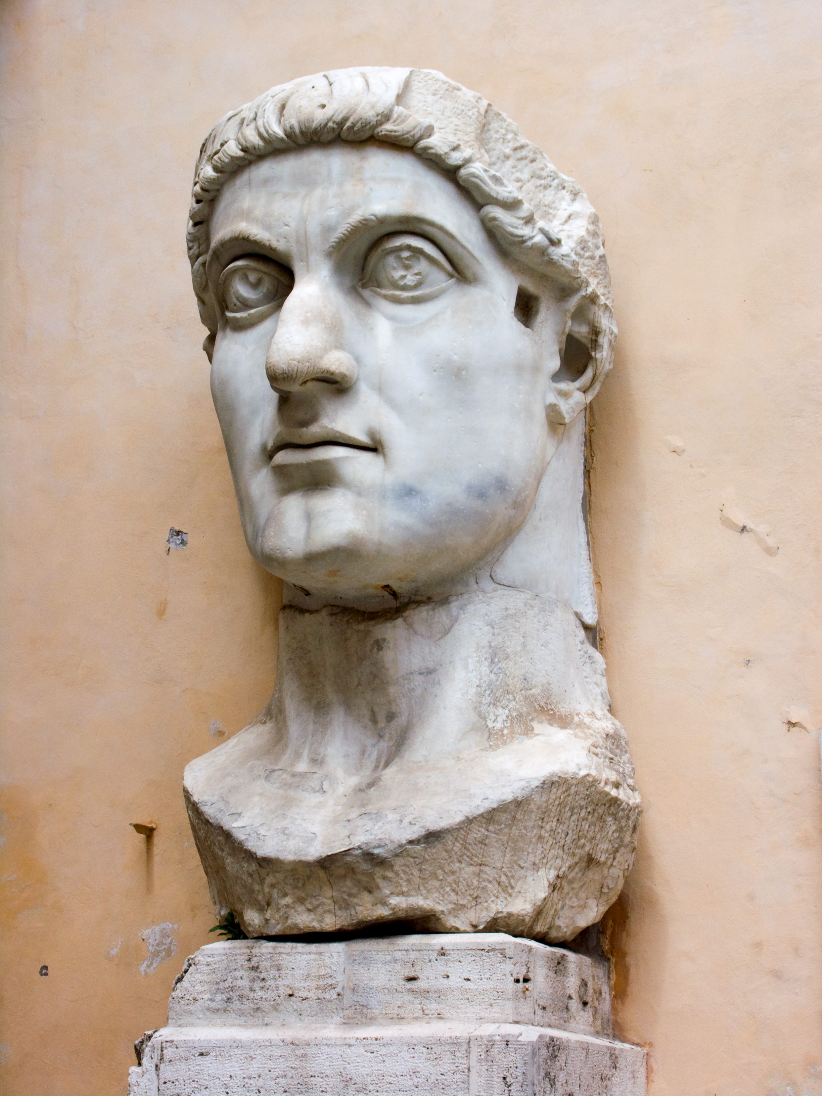
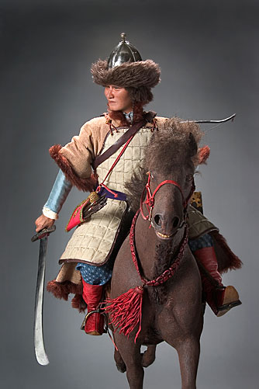
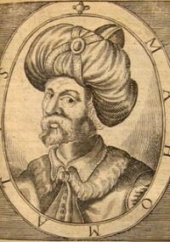
Constantino (336), Átila (453), Maomé (632), Henrique I (1060)

Slide 15
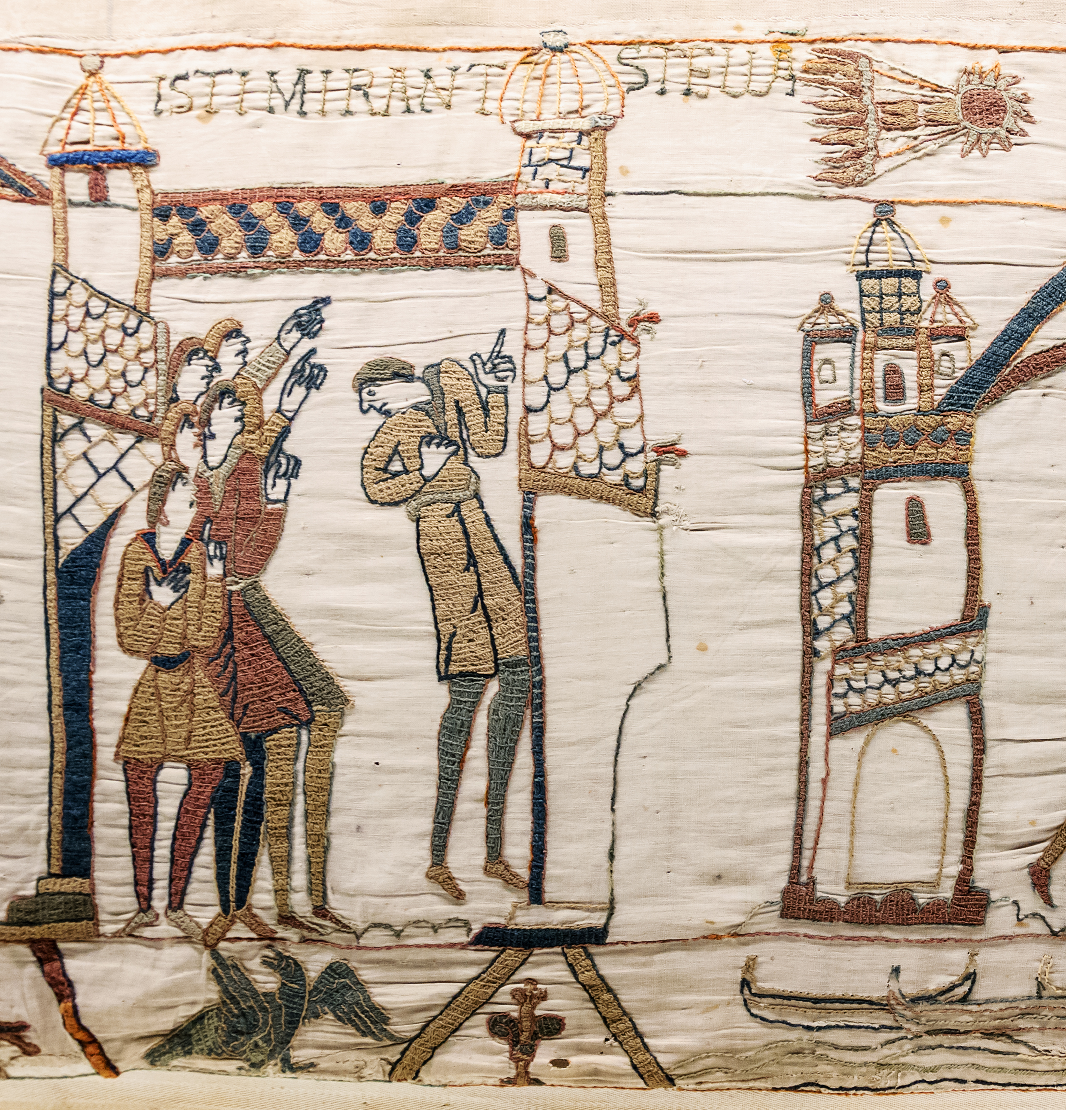
Conquista da Inglaterra pela Normandia: 1066

Slide 16
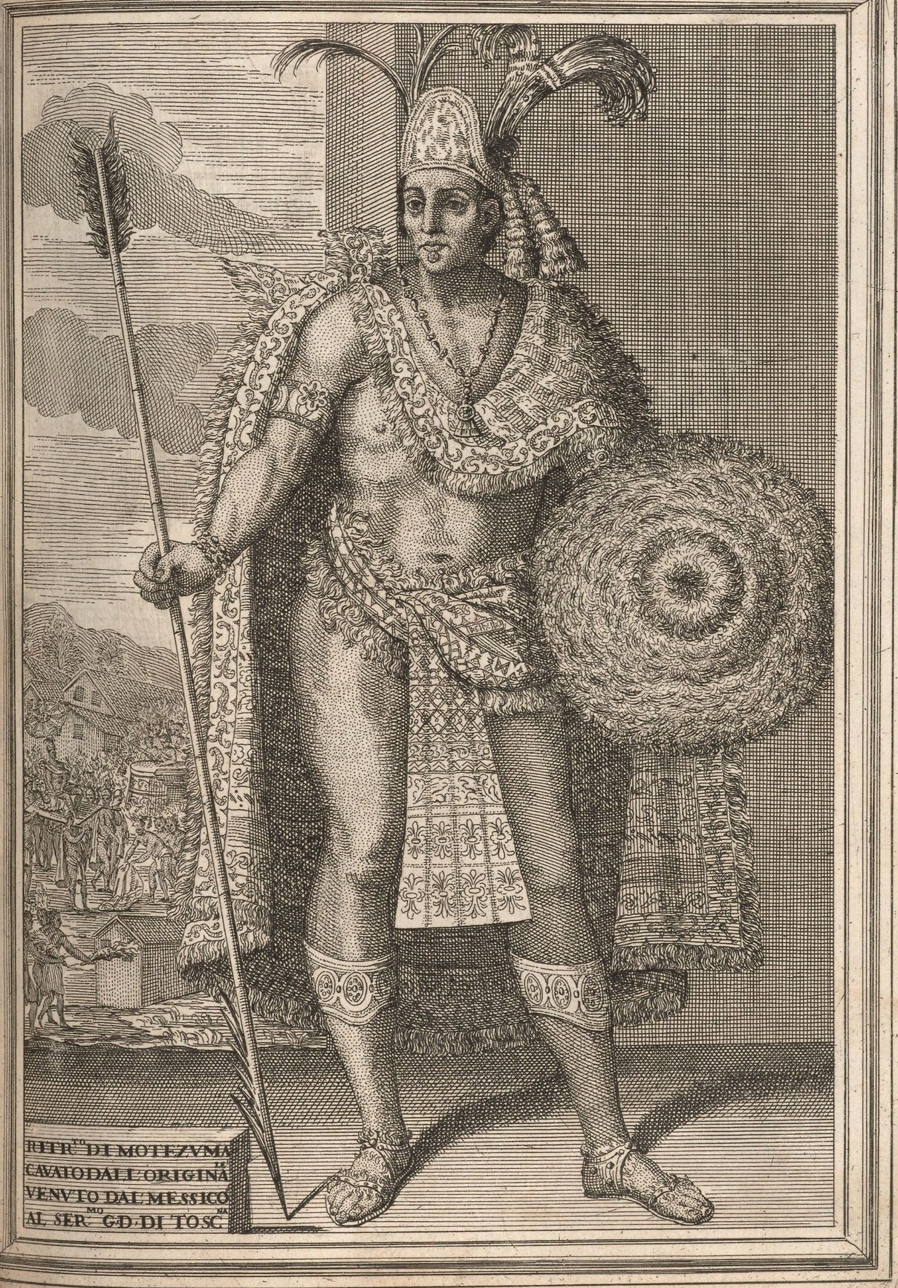
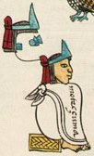
Montezuma II: 1519 e 1533

Slide 17
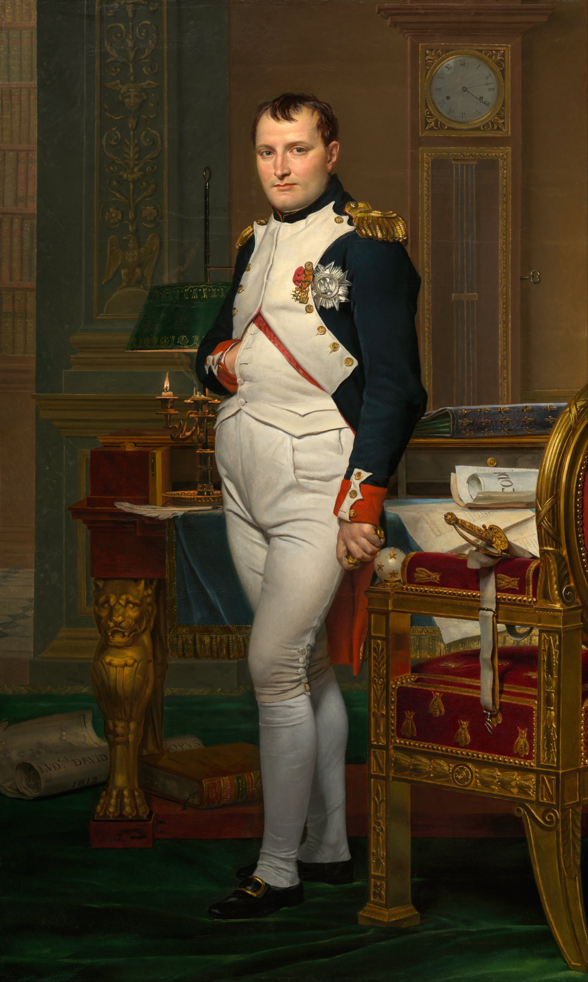
Napoleão: 15/08/1769 – 5/5/1821

Slide 18
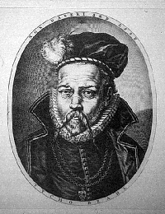
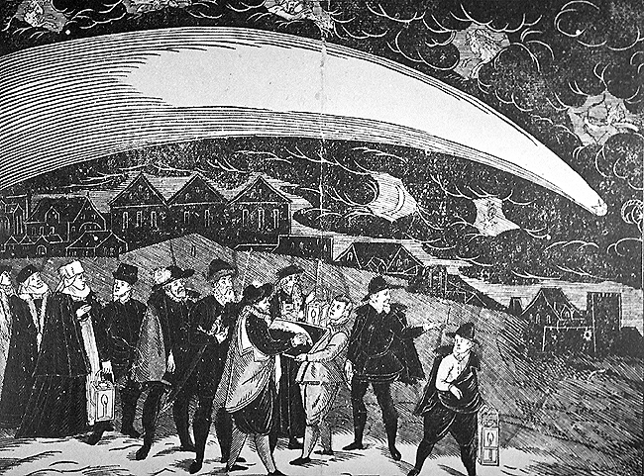
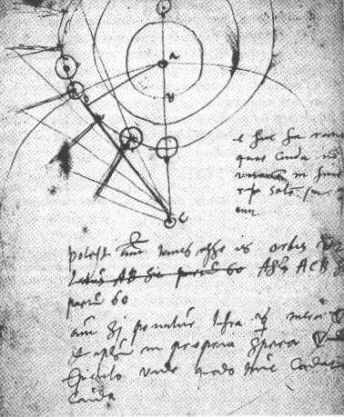
Tycho Brahe e o Grande cometa de 1577

Slide 19
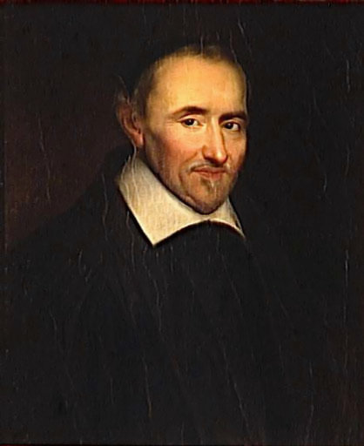
Gassendi, 1650: nossa estupidez nos mata

Slide 20
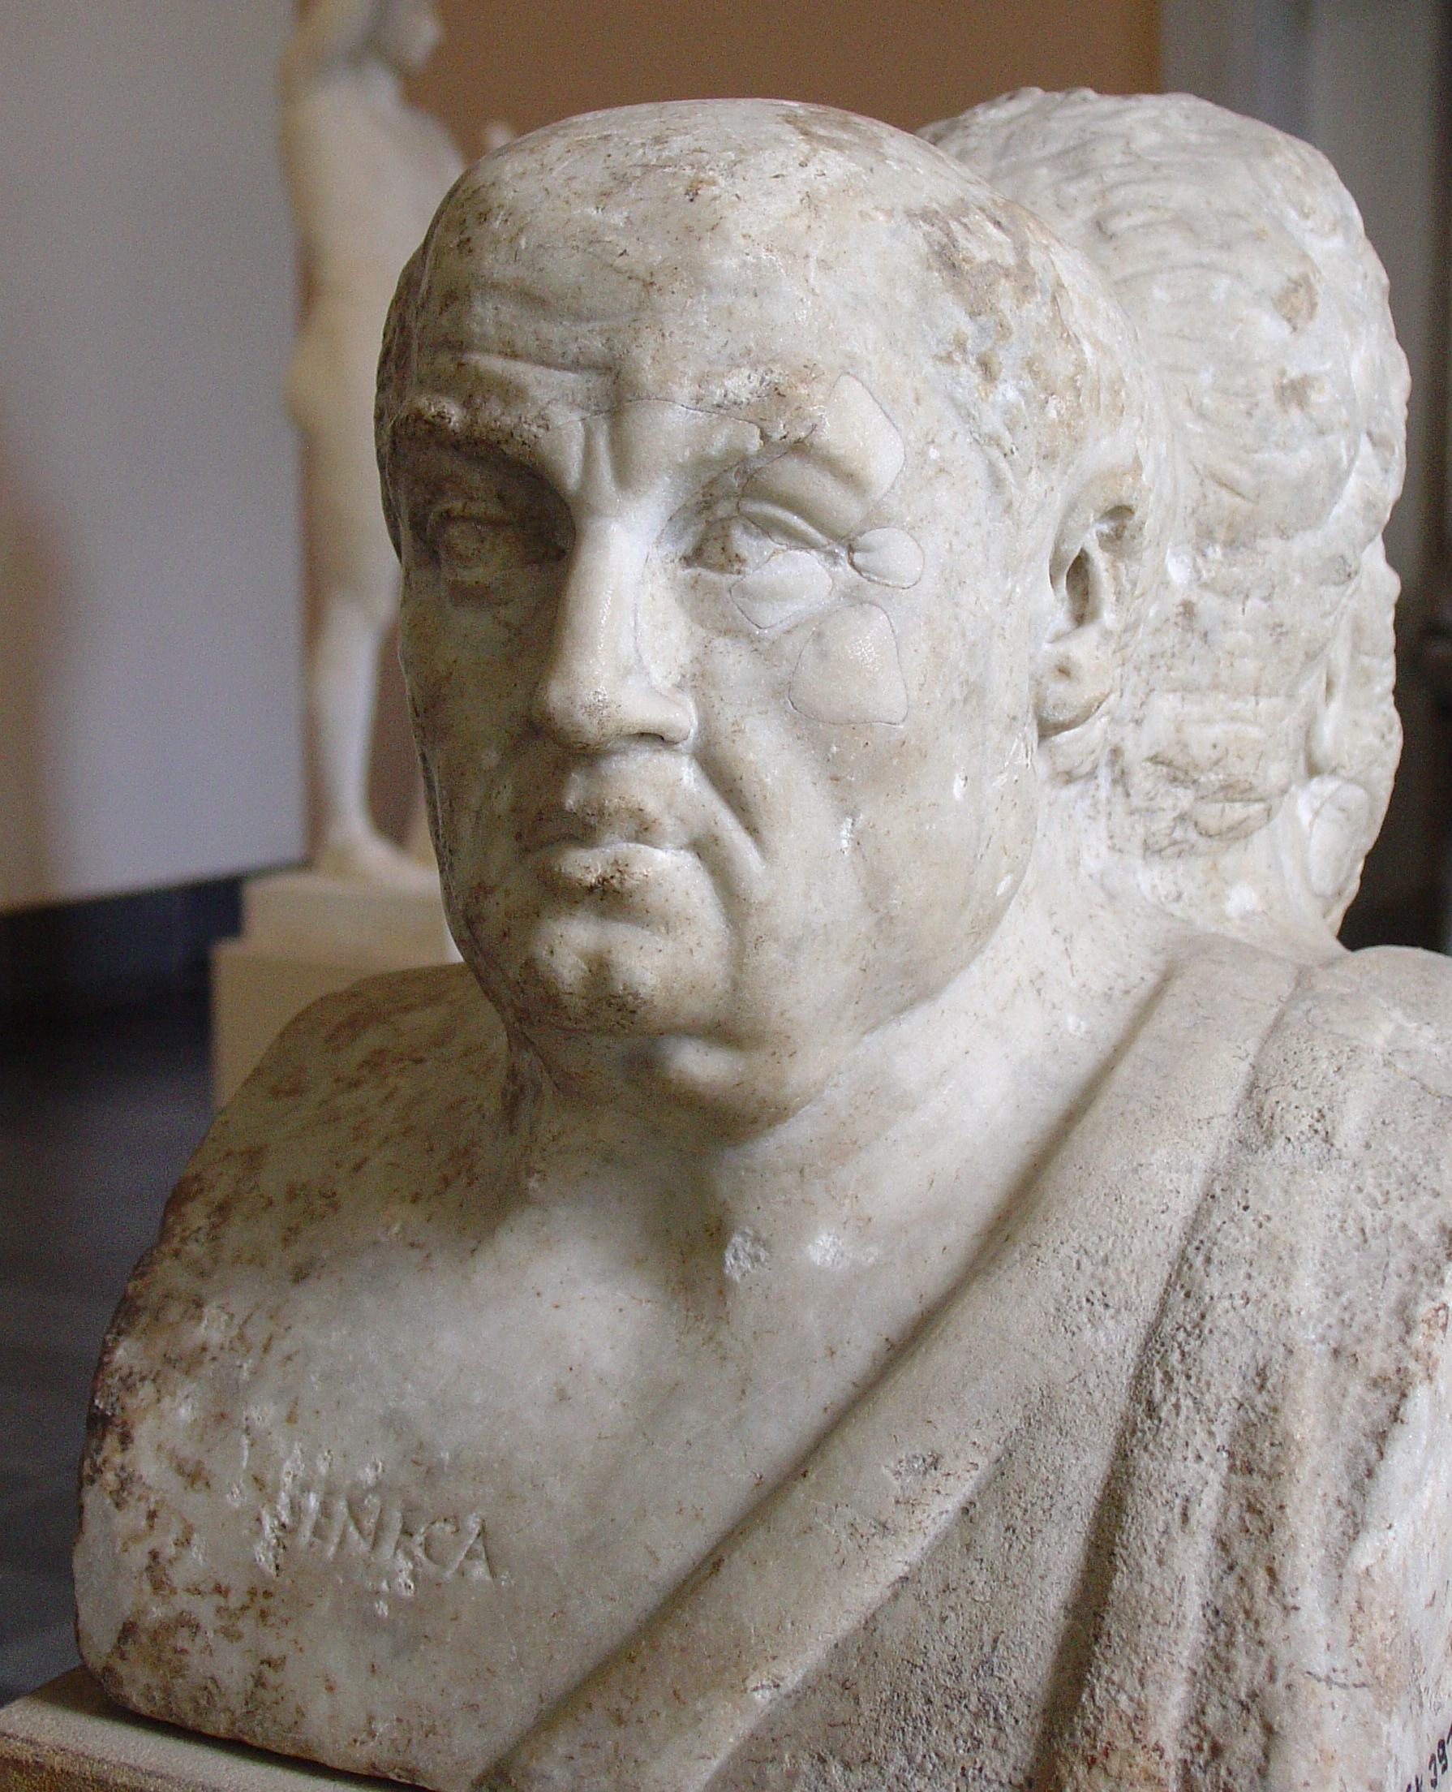
Sêneca: Naturales Quaestiones, 65 d.C.

Slide 21
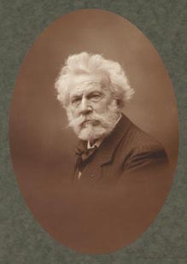
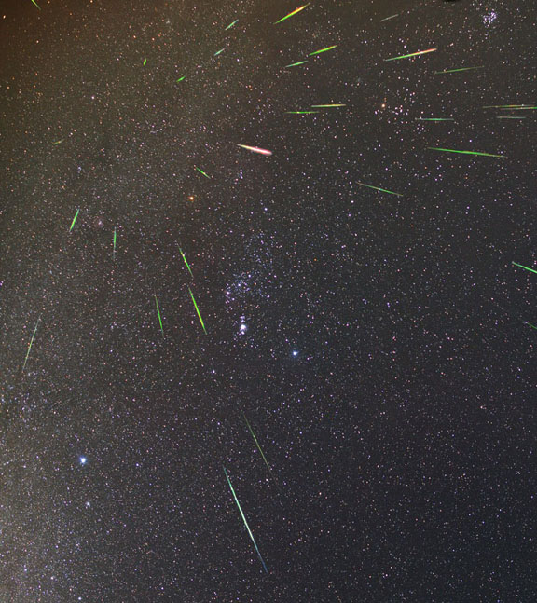
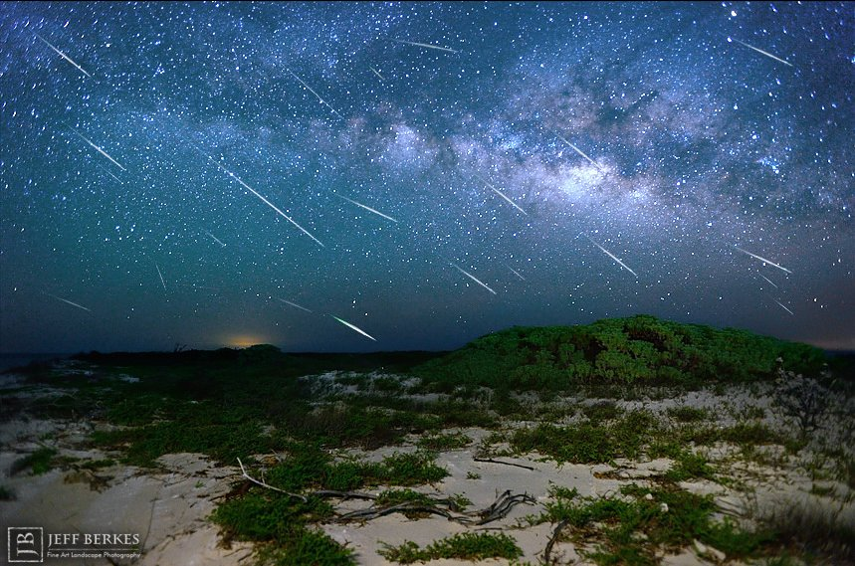
1910: Camille Flammarion e a cauda do Halley

Slide 22
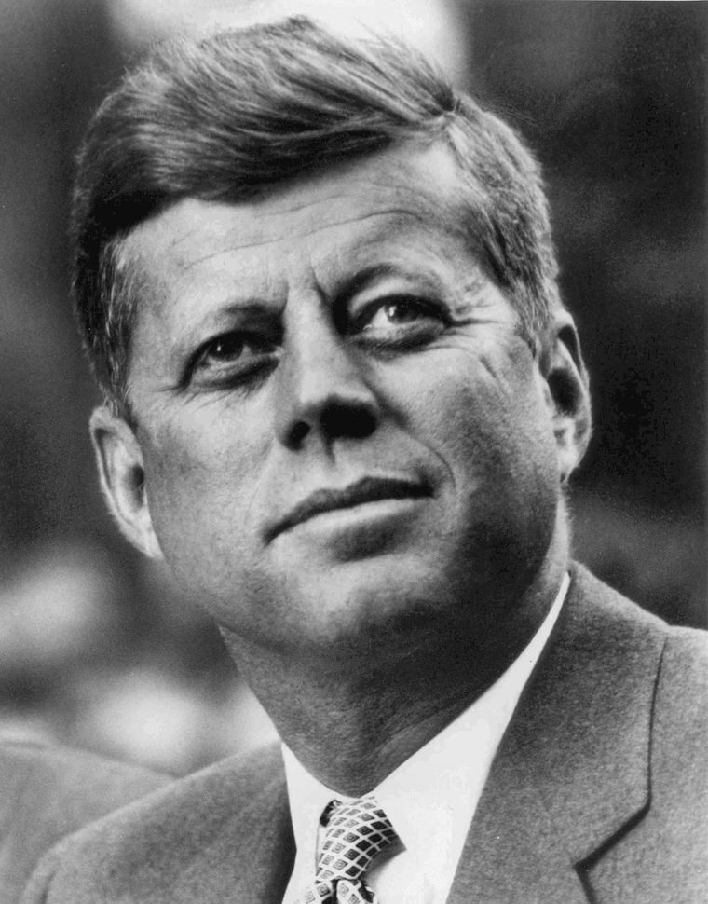
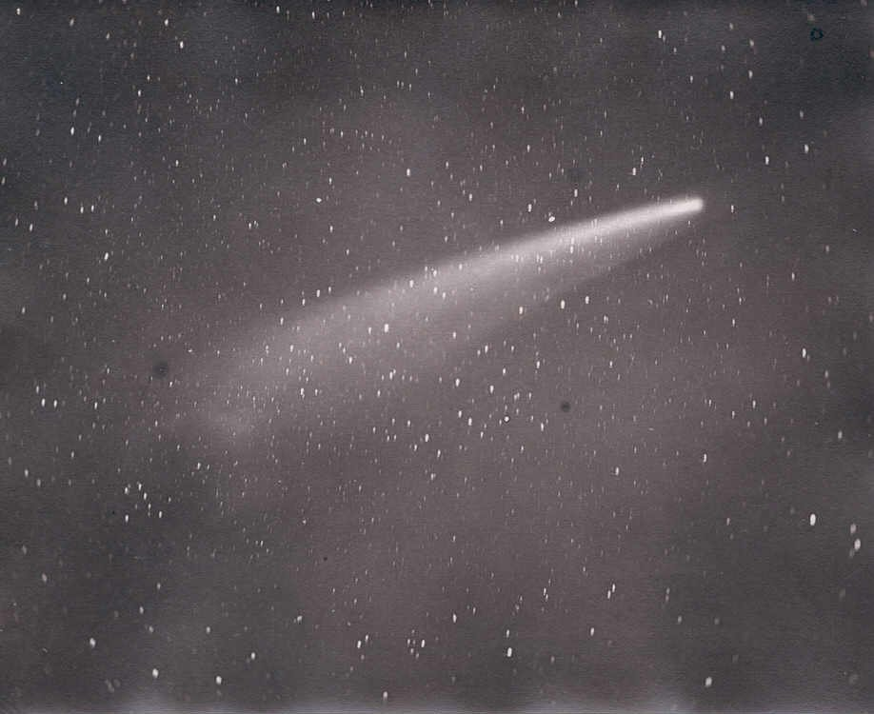
Cometa Pereyra e Presidente Kennedy: 1963

Slide 23
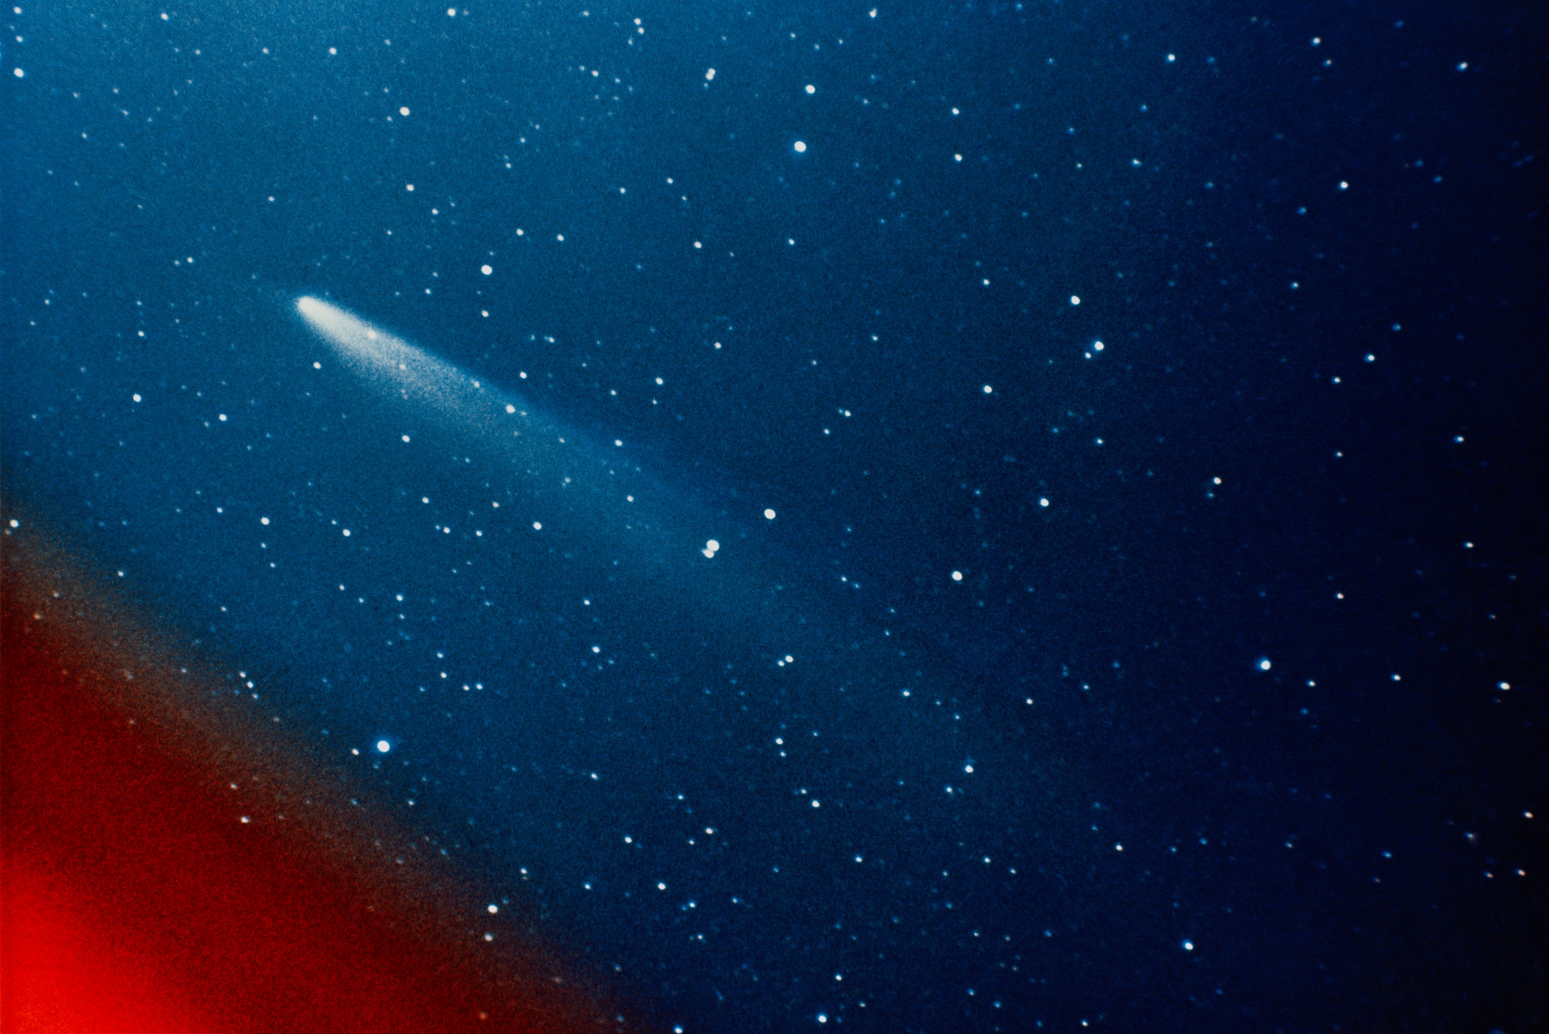
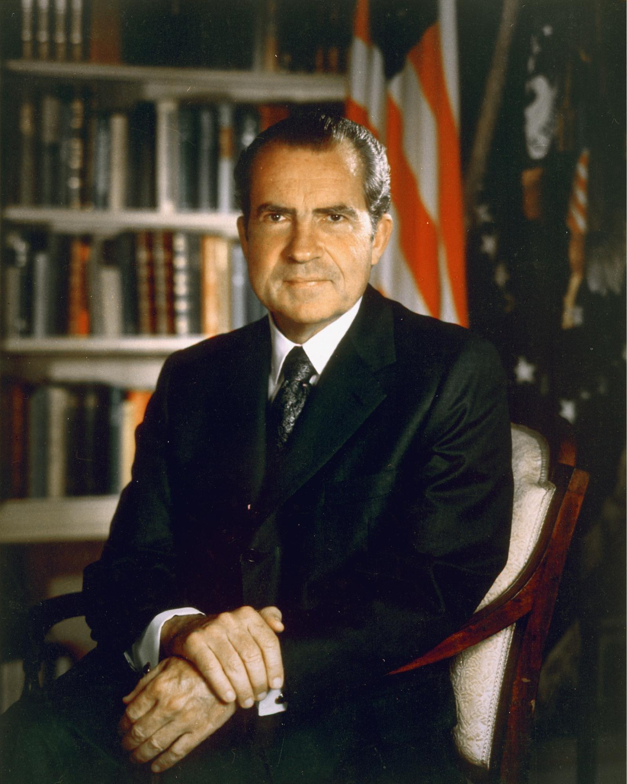
Kohoutek e o Presidente Nixon: 1973/74

Slide 24
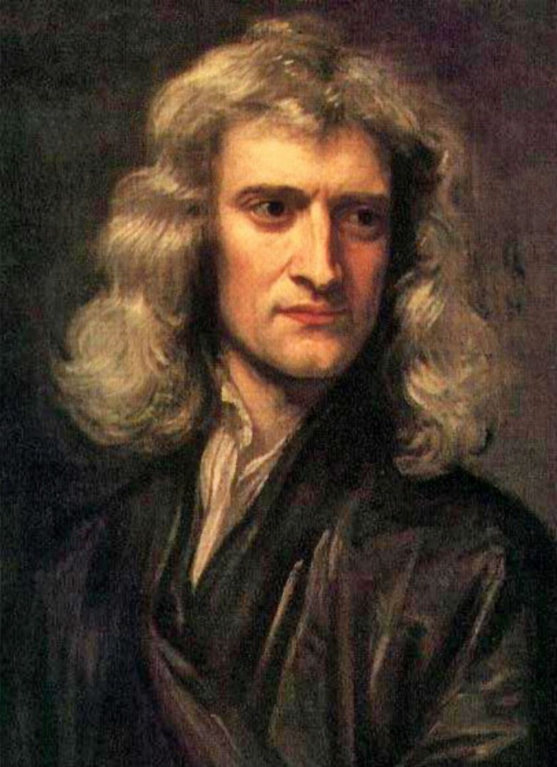
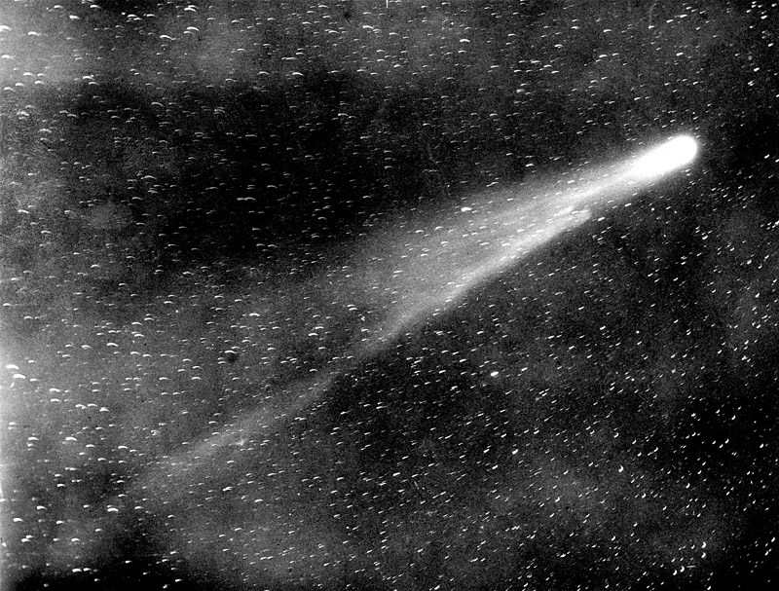
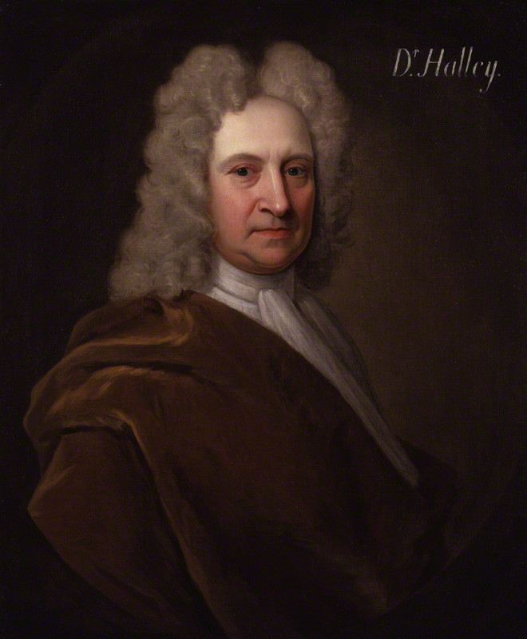
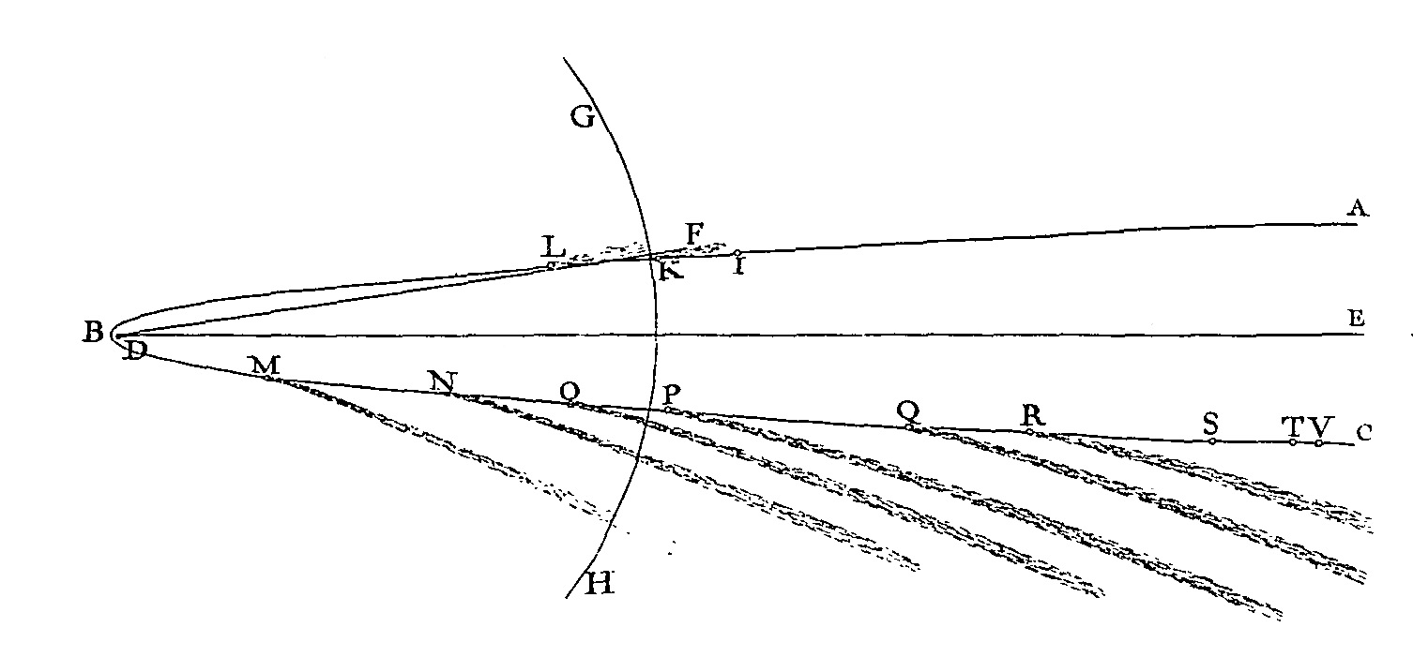
O cometa de Halley: 1705

Slide 25
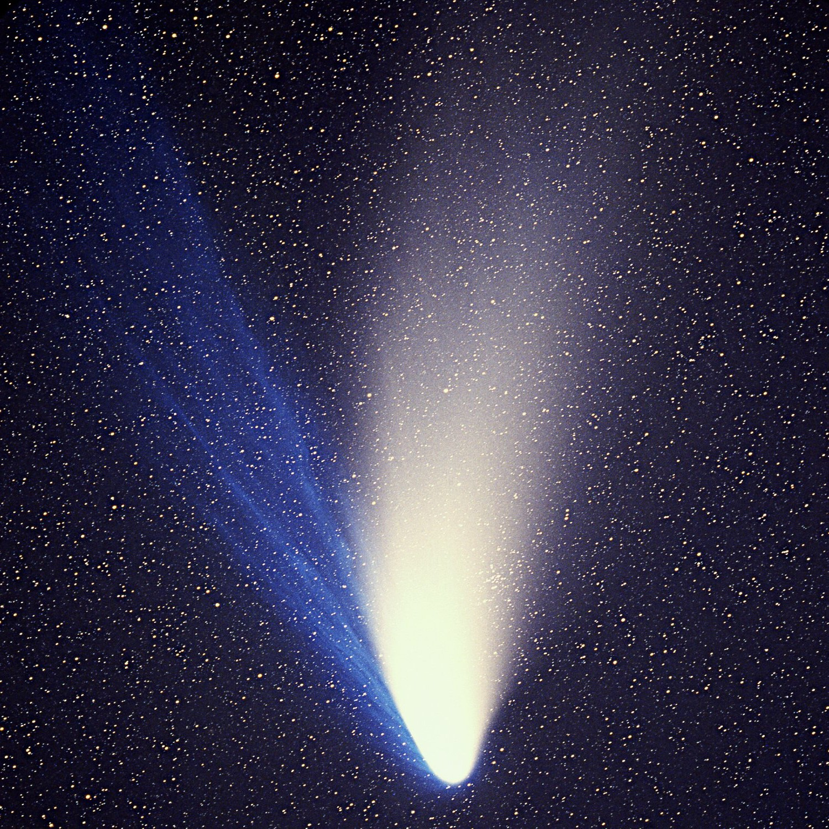
O cometa Hale-Bopp: 1995/1997

Slide 26
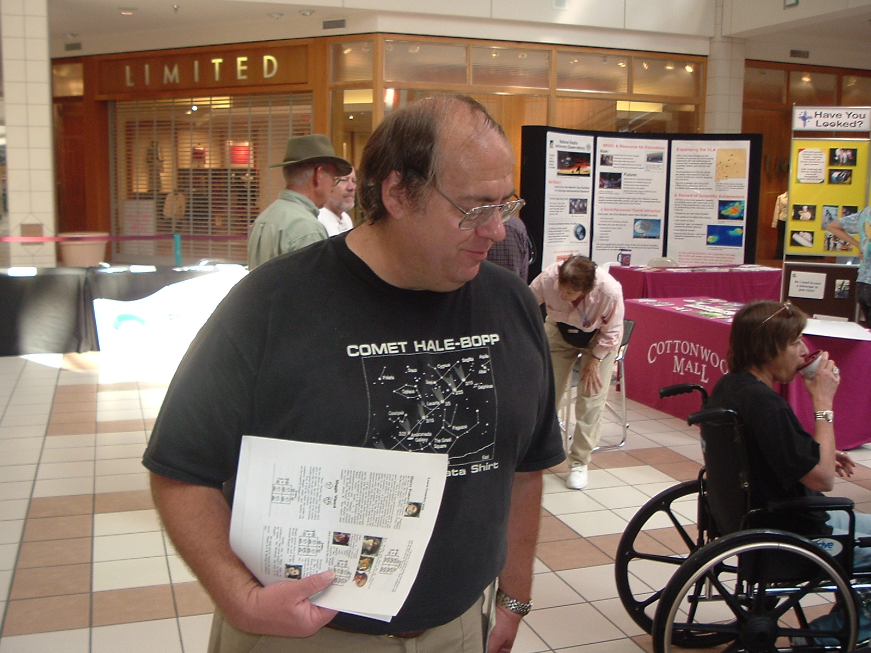
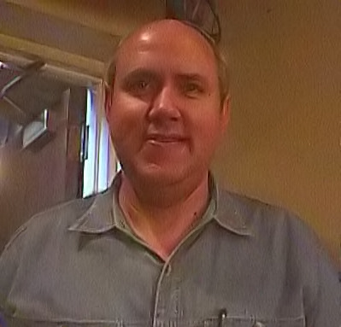
Alan Hale e Thomas Bopp: 1995

Slide 27
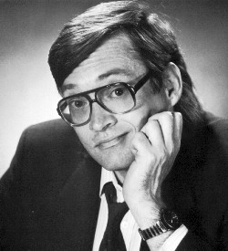
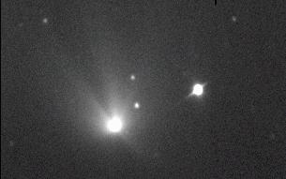
Chuck Shramek (1996) e Heavens Gate (26/03/1997)

Slide 28
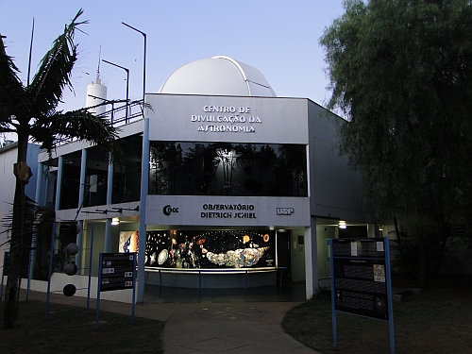
Observatório Dietrich Schiel

Slide 29
Dúvidas?

Slide 30
Obrigada!
www.cdcc.usp.br/cda
barroslgr@gmail.com

Slide 31
Referências Bibliográficas

Slide 32
Imagens desta Apresentação
Xu, Zhentao, David W. Pankenier, and Yaotiao Jiang. East Asian Archaeoastronomy: Historical Records of Astronomical Observations of China, Japan and Korea. Amsterdam, Netherlands: Earth Space Institute Series by Gordon and Breach Science, 2000. 109. Print.
Raffigurazione di Diodoro Siculo
Bust of Aristotle. Marble, Roman copy after a Greek bronze original by Lysippos from 330 BC; the alabaster mantle is a modern addition.
Bust of Plutarch at Chaeronea
Timoleon from "Promptuarii Iconum Insigniorum"
detalhe: Retrato de GiottoCinque maestri del rinascimento fiorentino, detalhe: Giotto
Giotto, na Capela Scrovegni
Exposition au Grand Palais "Moi, Auguste, empereur de Rome" (19 mars 2014-13 juillet 2014) Vers 44 av. JC Marbre blanc
Coin minted by Augustus (c. 19–18 BC); Obverse: CAESAR AVGVSTVS, laureate head right/Reverse: DIVVS IVLIV[S], with comet (star) of eight rays, tail upward.
https://commons.wikimedia.org/wiki/File:Ambroise_Pare,_Les_Oeuvres,_1579;_fearful_comet_Wellcome_L0021174.jpg
Illustration from the Nuremberg Chronicle
Bust of Nero at the Capitoline Museum, Rome
Statue de Constantin Ier, Musée du Capitole, Rome
"Attila the Hun" portrait by sculptor George S. Stuart
http://conteudo.imguol.com.br/c/noticias/2015/05/21/maome-muhammad-1432237377712_200x285.jpg
https://www.wikitree.com/photo.php/e/eb/Henri_I.jpg
La comète de Halley, vue du 24 avril au 1er mai 1066 – soit quatre mois après l'avènement d'Harold – figurant sur la Tapisserie de Bayeux – scène 32. L'inscription, ISTI MIRANT STELLÃ, signifie Ceux-ci admirent l'étoile : on voit un groupe de six anglais à l'extérieur du palais royal ; cinq ont le nez en l'air et l'index désignant la comète.
Portrait of Pierre Gassendi (1592-1655)
Moctezuma II, from the Codex Mendoza (folio 15v).
Moctezuma II, from Historia de la conquista de México by Antonio de Solis
Portrait of Napoleon in his forties, in high-ranking white and dark blue military dress uniform. In the original image He stands amid rich 18th-century furniture laden with papers, and gazes at the viewer. His hair is Brutus style, cropped close but with a short fringe in front, and his right hand is tucked in his waistcoat.
Observations by Brahe of the Great Comet of 1577
https://en.wikipedia.org/wiki/Great_Comet_of_1577#/media/File:Brahe2.gif
The Great comet of 1577, seen over Prague on November 12. Engraving made by Jiri Daschitzky.

Slide 33
Imagens desta Apresentação
Ancient bust of Seneca, part of a double herm (Antikensammlung Berlin)
Nicolas Camille Flammarion (1842-1925)
https://www.nasa.gov/sites/default/files/images/jeff-berkes-eta-aquarids-2013.jpg
http://www.skyandtelescope.com/observing/halley-on-fire-orionids-peak-this-week/
http://wwwcdn.skyandtelescope.com/wp-content/uploads/Orionids-2011-Phil-Hart-ST-OK_edited-1.jpg
https://ultralink.me/img/ul/0/d96c5a8e07d4cded0e98c7b6c60cc0be48aca7ad.jpg
Photo portrait of John F. Kennedy, President of the United States.
his color photograph of the comet Kohoutek (C/1973 E1) was taken by members of the lunar and planetary laboratory photographic team from the University of Arizona, at the Catalina observatory with a 35mm camera on January 11, 1974.
https://en.wikipedia.org/wiki/Richard_Nixon#/media/File:Richard_Nixon_President.jpg
Comet 1P/Halley as taken March 8, 1986 by W. Liller, Easter Island, part of the International Halley Watch (IHW) Large Scale Phenomena Network.

